Slide 1


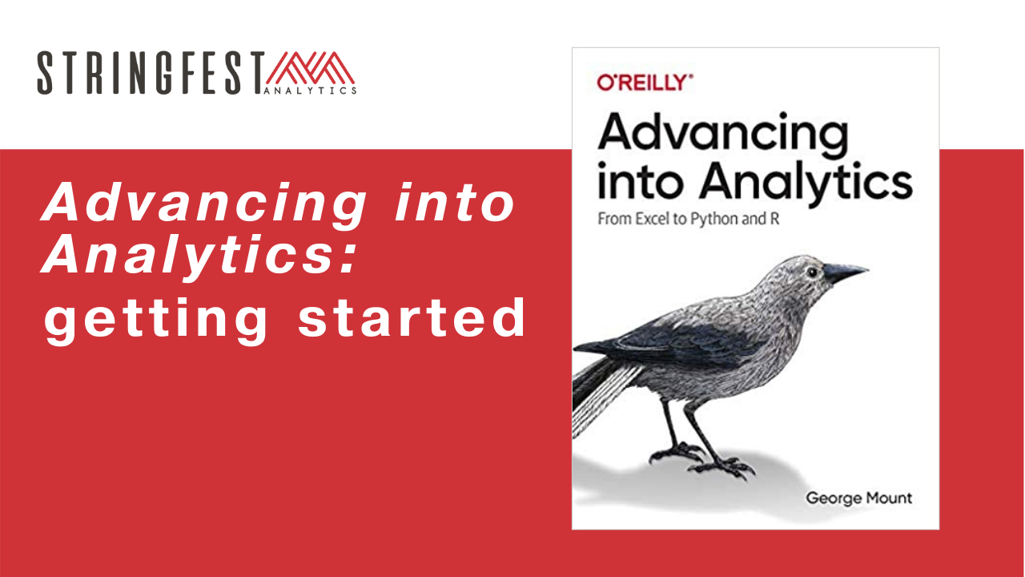
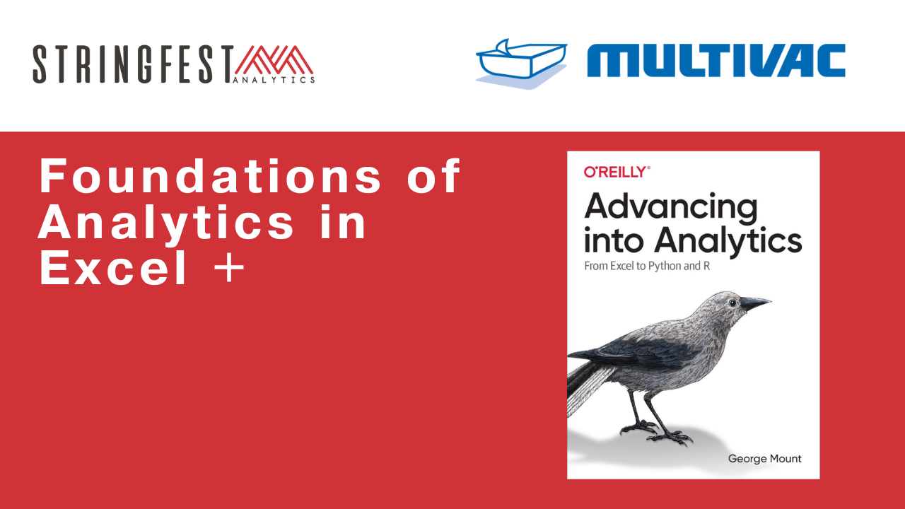
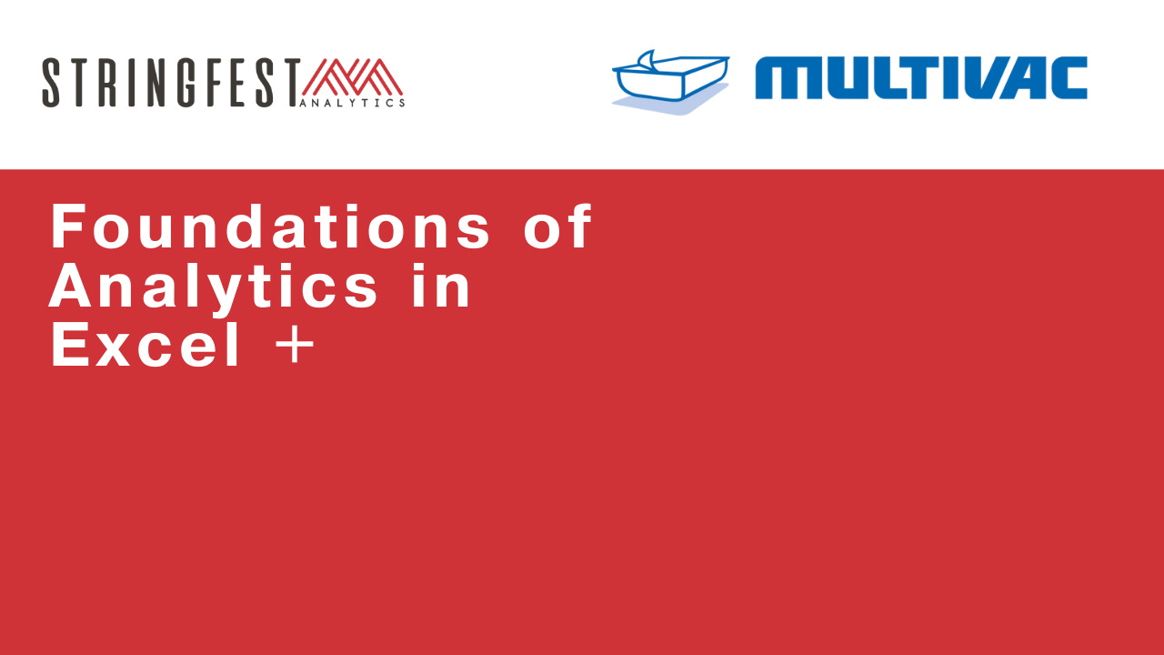
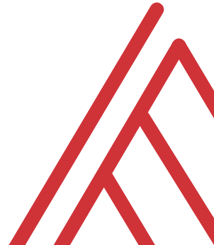
Advancing into Analytics: From Excel to R and Python
Notes:
The plus is because we will be looking at closely pairing tools that do closely pairing work.

Slide 2
Follow along
Download resources: https://swiy.co/mv-download
Unzip folder
Slido: https://swiy.co/mv-slido

Slide 3
Questions?
Notes:
Any questions so far about using R?
Again I just want to show you how easy it is to get up and running there as an Excel user and what to expect when working with open source programs.
Now I guess one of the questions I might have in your shoes is what’s the big deal, we can do the same kind of stuff with Power Query. So I want to acknowledge that.

Slide 4
Objectives for today
Clean data in Excel
Analyze it in Excel
Script it all in Python
Notes:
Polls

Slide 5
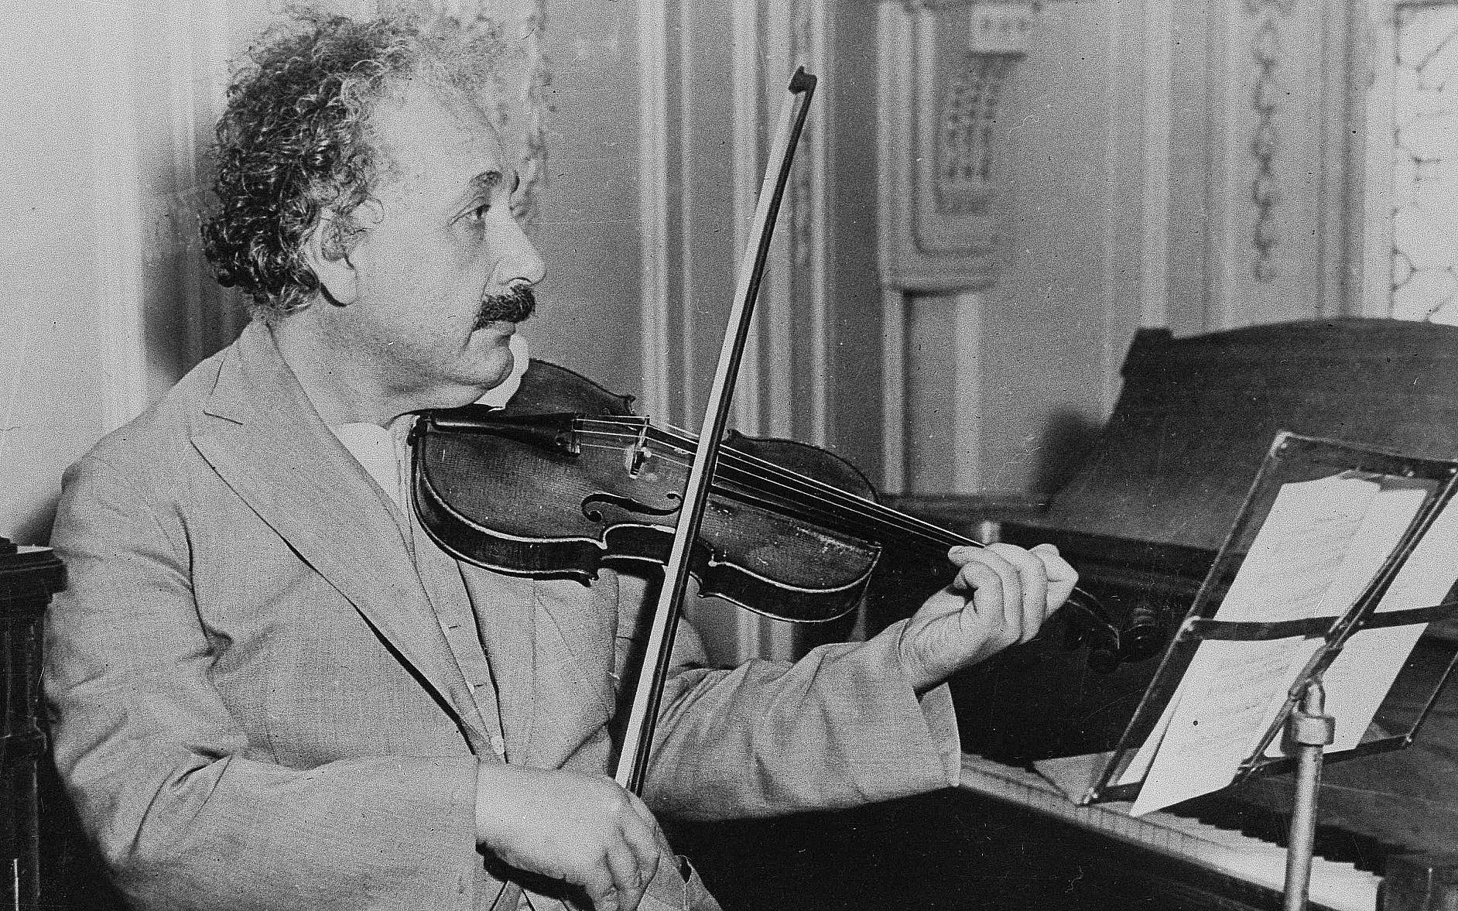


3 Fun Facts about me
Like Einstein in this one way…
My Duolingo jam
This was never me…
Notes:
So this means anyone is free to build on it or redistribute it… and that’s how we’ll get our code

Slide 6
~3 Fun Facts about you
… plus your learning objectives
Notes:
It doesn’t have to be 3, but something fun. Also let me know what you are hoping to get out of the workshop. --------------

Slide 7
Tentative schedule
Notes:
So this means anyone is free to build on it or redistribute it… and that’s how we’ll get our code

Slide 8

Objectives for today
No question too big or small
Balance actual & plan
Use drills when helpful
This is your time… the time for unkempt and unanalyzed data is over!
Notes:
So this means anyone is free to build on it or redistribute it… and that’s how we’ll get our code

Slide 9
Objectives for today
Prizes for participating!-
Notes:
And because this is your time I want to reward you for that. I was an econ major so I understand opportunity cost.

Slide 10
Questions?
Notes:
Any questions so far about using R?
Again I just want to show you how easy it is to get up and running there as an Excel user and what to expect when working with open source programs.
Now I guess one of the questions I might have in your shoes is what’s the big deal, we can do the same kind of stuff with Power Query. So I want to acknowledge that.

Slide 11
I. Importing the data… Power Query

Slide 12

LESSON OBJECTIVES
Load data from Excel workbooks and csv files into Power Query
Perform common data wrangling and cleaning tasks
Combine data from multiple sources

Slide 13
FOLLOWING ALONG
Each section is a sub-folder
Demos = follow along with me
Drills = try it yourself
Refresh your memory with the demo notes
Notes:
This is an Excel class, so we won’t be looking at PowerPoint the whole time – to follow along, you will see that all assets are divided by section.
Some of our Excel time will be Demos – for this I will be walking through some procedure in Excel.
If you need any datasets they will be included in each sub-folder.
Then there may be a Drill where you will work on it for yourself during some specified period of time.
I have provided written notes/instructions about the Demos which you can refer to while working on the Drills.

Slide 14
1. POWER QUERY AS EXCEL’S ETL TOOL
Notes:
One thing you’ll see that’s interesting about Power Query is that is has brought a lot of best practices in IT into Excel, one of those being the “extract, transform and load” methodology. So, I want take a brief pulse check here, is this a term you have heard of before? And honestly if you don’t, that’s why you are here.

Slide 15

What the @%&! is ETL?
“A properly designed ETL system extracts data from the source systems, enforces data quality and consistency standards, conforms data so that separate sources can be used together, and finally delivers data in a presentation-ready format so that application developers can build applications and end users can make decisions.”
-- (where else but) Wikipedia
Notes:
Now I’m going to be very scientific here and go to Wikipedia to explain how extract, transform, load or ETL methodologies work.

Slide 16








1. EXTRACT
2. TRANSFORM
3. LOAD
Notes:
So, you can see ETL achieves quite a few purposes, and as the name implies it works in three steps:
- First, you want to extract the information from some outside source, this can be anything from a database to a web page.
- Then, you want to transform it. This could be cleaning the data, filtering it, checking for assumptions, you get the idea.
- Finally, loading the data, this places it in a format that is accessible for end users to work with.
https://unsplash.com/photos/QUHlPs4y8PQ
https://pixabay.com/photos/tee-tea-bags-teas-drink-herbal-tea-1252397/
https://pixabay.com/photos/construction-worker-welding-welder-1717893/
https://pixabay.com/photos/gift-box-gifts-packaging-box-2458012/

Slide 17

Power Query & Excel Myth-busting
https://giphy.com/gifs/mythbusters-gif-qVuWpc7MxvGz6
Notes:
As I mentioned, ETL is all over the IT landscape and is considered a best practice when you are working with large amounts of disparate data that need to be “fit for general office consumption.” It’s not just an Excel thing, and in fact this is a pretty disruptive tool to have in Excel, and it really busts a lot of the myths about what Excel can and can’t be which I would like to cover right now.

Slide 18

1. “EXCEL IS NOT REPRODUCIBLE”
Notes:
https://pixabay.com/photos/laboratory-analysis-chemistry-2815641/
Now, the idea of reproducibility is that, the process of getting to some output is fully transparent and it’s possible to walk through each step of the process and get the same result at the end. A lot of typical Excel reporting is not fully reproducible, for example consider a report that depends on you deleting columns A through C to work. Now, if I was going into that final report to understand how it was built, there would really be no way for me to know that, right? On the other hand, a fully reproducible report would show me that, and ideally I’d just click a button and it would do it for me.
In data work, reproducibility is often achieved by powering an analysis with code, so that you can indeed run a script and watch the results emerge one line at a time. Now, the nice thing about Power Query is that it is a code-driven process, so it is reproducible. So does this mean you need to learn how to code in this class? Not necessarily right now. For everyday data cleaning processes, we can use menu-driven options, that will produce code in a Microsoft computer language called M, and now our data-cleaning steps are fully reproducible, in Excel, with no code needed. So that is really cool and a huge myth busted.

Slide 19

2. “EXCEL ONLY DOES STRUCTURED DATA”
Notes:
https://pixabay.com/illustrations/grid-isolation-table-lamp-beetle-2088884/
This is the type of data that in fairness we are more used to working with in classic Excel, data that comes in a nice rectangular shape, usually coming from an Excel workbook or csv file. If the data were in a so-called “unstructured” format, such as song lyrics or a website structure, good luck with using Excel for that.
Come over to Power Query and there is quite an expanded range of possibilities for where data can come from [list on the next page]

Slide 20
Access
.txt and .csv files
SQL Server & other relational databases
XML, HTML & Web data
SharePoint
Hadoop
oData
Combinations of the above…
Notes:
Slido poll, what sources are you working with?

Slide 21

3. “EXCEL CAN’T HANDLE LARGE DATASETS”
Notes:
And that’s the last myth I want to bust here, is that Excel can’t handle large datasets. Now, with “classical Excel” this was probably true, that Excel just couldn’t handle some of those bigger datasets that a lot of data analysts are working with these days, but that’s just not true when you are using Power Query [example on next slide]
https://pixabay.com/photos/amphibian-turtle-animal-armor-blur-1850190/

Slide 22
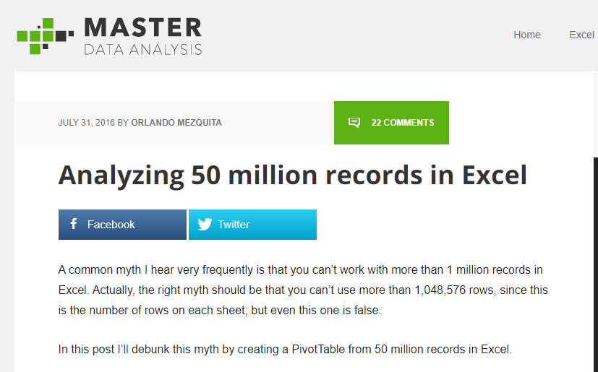
https://www.masterdataanalysis.com/ms-excel/analyzing-50-million-records-excel/
Notes:
Here is an example of that, a blog post about analyzing 50 million records using Excel. 50 million is pretty significant for most anyone, and Excel could handle it, so dismissing Excel out of hand on account of performance is just not as true anymore with Power Query.

Slide 23
What did we do before Power Query?
File: wholesale-customers.xlsx
How would you make this data “PivotTable-ready?”
Notes:
Now you are hyped up Power Query, I think you are going to love it and it will be hard for you to remember the days when you didn’t have it. So let’s think about what we would do without Power Query.

Slide 24
QUESTIONS?

Slide 25
2. WHAT MAKES DATA TIDY?
Notes:
An example that should sound familiar to you as a data analyst follows on the next slide.

Slide 26

Notes:
It’s not even like a box of chocolates, because we KNOW we are going to get something dirty & unfit for consumption.
If you do anything with data you know how much time is spent cleaning it. You never know what is going to come through that attachment.
And Power Query will indeed help you automate some of these process that you go through every week, such as deleting columns, sorting rows, etc, and you won’t necessarily have to write code like you would have in VBA. But what Power Query can’t tell you is how the data should be shaped. You should have some “attack plan” when you encounter a dataset so that you are “beginning with the end in mind,” that is, a dataset that will be easy to analyze.

Slide 27
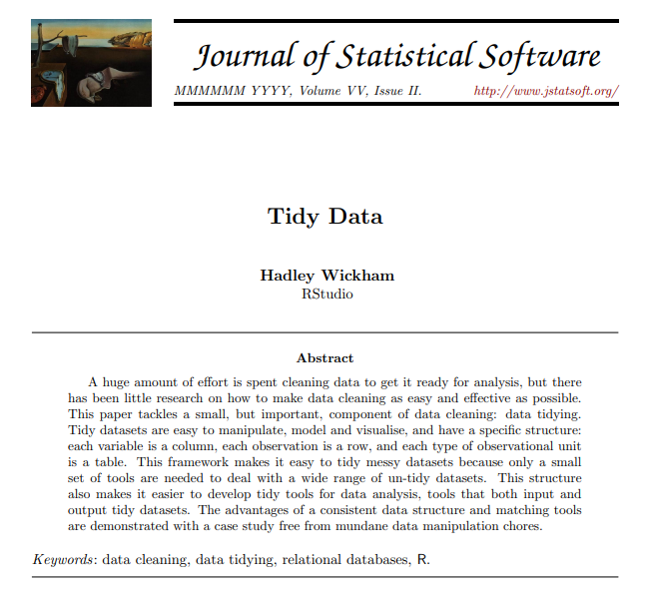
TIDY’S ORIGINS
http://vita.had.co.nz/papers/tidy-data.pdf
Notes:
And the paradigm we will borrow from to do that comes from Hadley Wickham, a statistician and prolific author of R packages. Wickham wrote a paper called Tidy Data that gave some pointers for how to clean datasets so that they are optimized for analysis.
I have included a copy of this paper in the repo, you can also download it at the link.

Slide 28
OBSERVATIONS AND VARIABLES
Observation: The entity that was measured
Variable: What was measured
Notes:
It’s really pretty brilliant and like a lot of brilliant ideas, it’s rather simple: We want to break our data into two categories, observations and variables. There are also sometimes called dimensions and measures. A good way to think about this is that observations are going to be fixed by the design of our data collection, and variables will be measured during the course of the experiment.
So, if you are measuring the heights of individuals, each person would be an observation, and height would be the variable.
It’s one of those concepts that “you know when you see,” so let’s practice a little more.

Slide 29
DRILL
Which attributes are observations, and which are variables?
Attribute | Observation or variable?
Store #
Month
Sales
Notes:
Which is which? [Answers on next slide]

Slide 30
DRILL
Which attributes are observations, and which are variables?
Attribute | Observation or variable?
Store # | Observation
Month | Observation
Sales | Variable
Notes:
One thing to consider here is that observations do not necessarily have to be “letters,” for example Month could be represented as 1,2,3 or Jan,Feb,Mar.
So, what does this distinction have to do with data cleaning? [next slide]

Slide 31
WHAT MAKES DATA TIDY?
Notes:
We want to have our data organized so that each variable is its own column, and each observation is its own row. So, if you remember our wholesale sales dataset, Category would have been an observation, and Sales a variable. We should have had Sales as one column, and then Category went down the rows.
There is one more principle of “tidy” data that we will not explore, it gets into concepts related to database normalization, but for our purposes thinking about having every variable in its own column is going to be of tremendous help.
We should also remember that every cell should be some populated intersection of an observation/variable! That means that merged cells, unrepeated fields, even totals are not going to be tidy for us. We want it in this form to analyze.
And you can get a sense of some of these pain points if you have ever built a PivotTable, it does not take kindly to some of these cosmetic tweaks that are often made to datasets. To practice what some of those tweaks are and what we would want to do to get the dataset to tidy, a couple of drills follow.

Slide 32
DRILL
How would we tidy this dataset?
(Don’t do, just think)
Notes:
What if you were given a dataset like this, what would you do with it so you could actually analyze it?
Note that you don’t actually have to re-shape this data, just think through what changes you would want to make.

Slide 33
SOLUTION
Notes:
A few things, right? First, get rid of all the excess rows and columns, unmerge and rotate the Model headers, move the Regions into a new column. You’ll see that this data moves from being “short and wide” to “tall and narrow” and that is one of those colloquial hallmarks of what happens when you make a dataset easier to analyze.
Let’s try one more.

Slide 34
DRILL
How would we tidy this dataset?
(Don’t do, just think)
Notes:
Here’s another one, how would you clean it up? Don’t actually do it, just think through it.

Slide 35
SOLUTION
Notes:
Same idea here, right? We have a “tall and narrow” dataset now.
To the uninitiated this does not look like a very helpful dataset, because look how many things are repeating, right! I mean we had such a nice little compact table before and now it’s this really long table.
However for the purposes of actually analyzing this data, this is a preferred state, because now we are free to re-summarize and re-aggregate as each observation now makes its own row, and each variable is its own column.

Slide 36
QUESTIONS?
Notes:
This all may seem like a lot of wind-up but it’s easy to over-emphasize the technology. It can’t tell us what to do. So before we start to use Power Query to clean data, we should have an idea of what clean data actually is!

Slide 37
3. FIRST STEPS IN POWER QUERY
Notes:
Let’s finally get into Power Query! We won’t really clean or transform anything here, but we will see an awesome built-in Power Query tool for exploratory data analysis.

Slide 38
DEMO
File: star.xlsx
Load into Power Query
Explore via Data Preview
Refer to demo notes
Notes:
Open this file. We will get into Power Query now.

Slide 39
DRILL
File: computers.xlsx
Load into Power Query
Explore via Data Preview
Don’t forget the Demo Notes if you get stuck
Notes:
Now do the same for the computers file.
Reminder that if you don’t remember how I did something in a demo, you can refer to the demo notes for written instructions.

Slide 40
QUESTIONS?
Notes:
Any questions on descriptive statistics?

Slide 41
4. TRANSFORMING ROWS IN POWER QUERY
Notes:
In this section we will do some common row-wise data transformation such as sorting, removing duplicates, filtering, filling and grouping a table

Slide 42
DEMO
File: office-rsvps.xlsx
Notes:
Any questions on descriptive statistics?

Slide 43
DEMO
File: regional-sales.xlsx
Notes:
Any questions on descriptive statistics?

Slide 44
DRILL
File: state-populations.xlsx
Worksheet: states
Name the query State populations.
Remove the United States row from the data.
Fill down blanks on the Region and Division columns
Sort by Population from high to low
Load results into a PivotTable
Worksheet: midwest_cities
1. Convert this data into a table where each city is in its own row.
Notes:
Any questions on descriptive statistics?

Slide 45
QUESTIONS?
Notes:
As you saw with the last solutions one of the best ways to learn is just to go the extra mile with your data sets, ask “what if” and start to play around. I can’t possibly show you all the row-wise operations because it’s really infinite in Power Query so the best thing we can do is with these little case studies where we start to play around with different options and combinations based on what we want to do with the data.

Slide 46
5. TRANSFORMING COLUMNS IN POWER QUERY, PART I
Notes:
Now, we’ve worked on making row-wise transformations, let’s focus on the columns. We may want to do things like reformat a column, change its data type or split is based on some delimiter.

Slide 47
DEMO
File: dvdrentals.xlsx
Notes:
Let’s practice on this DVD rentals dataset, this comes directly from this website, and we just want to do some various things to this data, so as always let’s do a Data, From Table, and now we are in our Query editor and we can do a few things.

Slide 48
DRILL
File: orders.xlsx
Convert the Date column to a month data type.
Convert the Account column to proper case.
Split the Opportunity column into three columns:
Vendor
Status
Order Type
Notes:
Any questions on descriptive statistics?

Slide 49
QUESTIONS?
Notes:
Some of what we did you may be familiar with – text to columns, reformatting a column, but actually changing a data type is different – we aren’t just cosmetically changing the data, or parts of the data, in Power Query, we are actually converting its type and that is really a different way of doing things, almost more like what you would do in a database. Pretty cool. Let’s continue with some more sophisticated column-wise transformation.

Slide 50
6. TRANSFORMING COLUMNS IN POWER QUERY, PART II
Notes:
This section will actually be in two parts.

Slide 51
6A. Transforming Columns
Notes:
First we will continue with some column transformations, in particular we will create calculated fields and then un-pivot a table.

Slide 52
DEMO
File: population-densities.xlsx
Notes:
Any questions on descriptive statistics?

Slide 53
DRILL
File: wholesale-customers.xlsx
Tidy this data!
Create a field calculating 10% of the sales called Tax
Notes:
Any questions on descriptive statistics?

Slide 54
6B. Appending Tables
Notes:
Next we will start to operate on multiple tables at a time, first by appending two or more tables together, which in some ways is a row-wise operation, but it’s based on columns so I think it still counts ☺

Slide 55
DEMO
Files: oscars_yes.csv, oscars_no.csv
Start with a blank Excel workboook
Notes:
Now we will switch it up a little bit

Slide 56
DRILL
File: hof_inducted.csv, hof_not_inducted.csv
Append these tables
Notes:
Any questions on descriptive statistics?

Slide 57
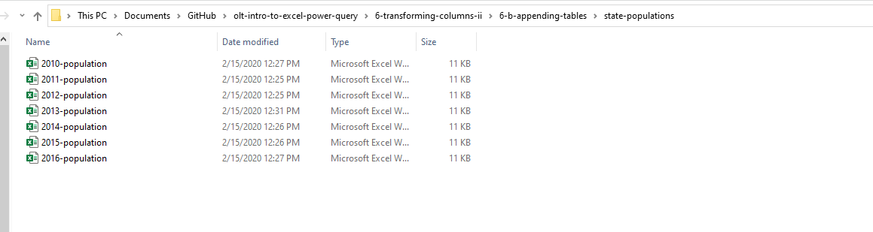
DEMO
Append from a folder of files:
Folder: state-populations

Slide 58
DRILL
baseball folder
This is a download of the csv version of the Lahman baseball database.
See if you can get a table of all files in this folder using Power Query.
In this case we do not want to transform the data, just load a table of the file metadata.
Notes:
This is actually the source data of the hall of fame tables.

Slide 59
QUESTIONS?
Notes:
Any questions on descriptive statistics?

Slide 60
QUESTIONS?
I have one:
Who are these people?
Notes:
It looks like the first two names are Ty Cobb and Babe Ruth but how would I know that for sure? It’s not English? Why are we using these? If you have done a lookup before you may know why. We are going to get a lot more advanced with them

Slide 61
6. VLOOKUP(), MEET JOIN

Slide 62
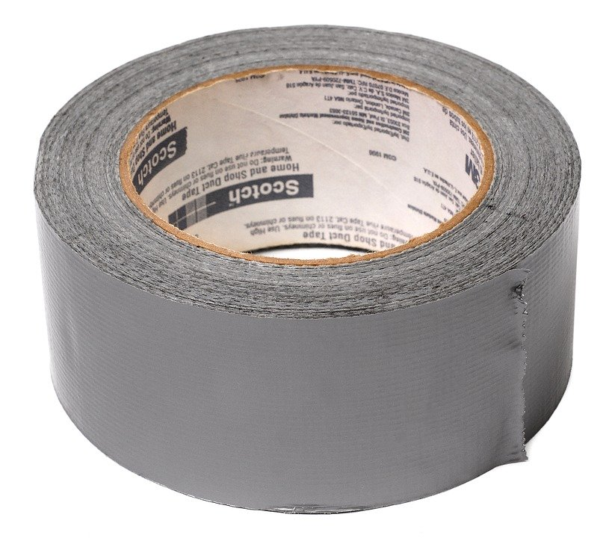

DUCT TAPE, MEET WELDER
VLOOKUP()
JOIN

Slide 63
DEMO
File: flights-and-planes.xlsx (the VLOOKUP way)
Notes:
Any questions on descriptive statistics?

Slide 64
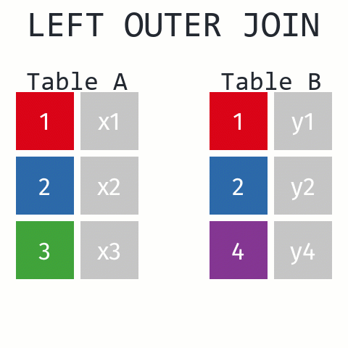
Returns ALL records from Table A and matching records from Table B. Results with no match are null.
https://github.com/gadenbuie/tidyexplain#mutating-joins

Slide 65
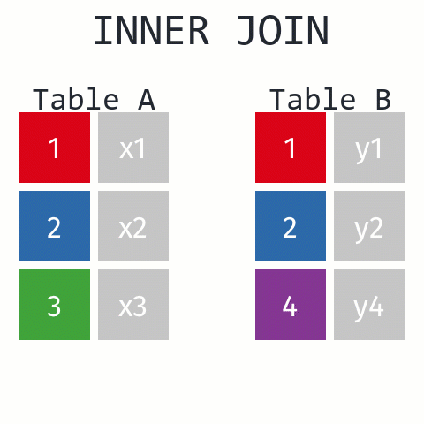
Returns records that have matching values in Tables A and B
https://github.com/gadenbuie/tidyexplain#mutating-joins
Notes:
These are R functions but the idea is the same.

Slide 66
DEMO
File: flights-and-planes.xlsx (the Power Query way)
Notes:
Now, let’s see what happens with our data when we use a join versus a lookup.

Slide 67
DRILL
Files: hof.csv, people-a-thru-m.csv
What is the result of a left outer join of hof on people-a-thru-m?
What about an inner join?
Notes:
Our source data only contains a list of the people with last names A thru M. How will this affect an inner join versus an outer join.

Slide 68
QUESTIONS?
Notes:
Any questions on descriptive statistics?

Slide 69
JOIN Beyond the basics

Slide 70
DATABASE JOIN TYPES
LEFT OUTER
RIGHT OUTER
A
B
A
B
FULL OUTER
A
B
INNER
A
A
LEFT ANTI
RIGHT ANTI
A
B
A
B

Slide 71
DEMO
File: championships-demo.xlsx
Which cities can claim only a baseball or football championship?
Left anti
Right anti
Baseball
Football
Baseball
Football
Notes:
Let’s imagine that our baseball team is the Left table and the Football teams is the Right table. If I only want the records of cities who have a baseball championship I can use a left anti. Vice versa for football cities.

Slide 72
DRILL
File: championships-drill.xlsx
Which cities can claim only a hockey or basketball championship?
Notes:
The illustrations follow on the next slide.

Slide 73
JOINS CAN GET EXOTIC
Cross join
TABLE A
TABLE B
1
2
3
1
2
3
https://www.tutorialgateway.org/sql-cross-join/
Notes:
Let’s look at another type of join that is often not listed as a join type but actually is and that is a cross or Cartesian join.

Slide 74
DEMO
File: office-employees.xlsx
Notes:
Any questions on descriptive statistics?

Slide 75
DRILL
Files: states.xlsx
Create a table to record each state’s bird, flower and capital
Notes:
Any questions on descriptive statistics?

Slide 76
QUESTIONS?
Notes:
Any questions on descriptive statistics?

Slide 77
7. CONCLUSION
Notes:
Thank you everyone for coming today, as you have seen Power Query is a beast. There is so much you can do, it really opens up the doors to not just Excel but the Microsoft BI stack as a whole, so let’s see what I mean here.

Slide 78
What to learn next?
M language
PowerPivot
Power BI
Notes:
As you are going to see, learning Power Query can take you in a lot of different directions, which is pretty mind blowing, because there are just so many ways to go and things to learn these days.
Manipulating the M language: This will let you write things like custom functions. This will also be a good gateway into things like re-using queries and customizing what stuff does.
Power Pivot: This is the data modeling language. So if you wanted to build something like a relational schema inside a workbook, and again this can be with data coming from all types of places, and you can even use Power Query to clean up that data and then Power Pivot to build relational models, pretty cool dynamic duo.
Power BI: This is the dashboarding/reporting/visualization part of the Microsoft BI stack. The cool thing is you’ve got a leg up for learning this, because Power BI also has Power Query!

Slide 79
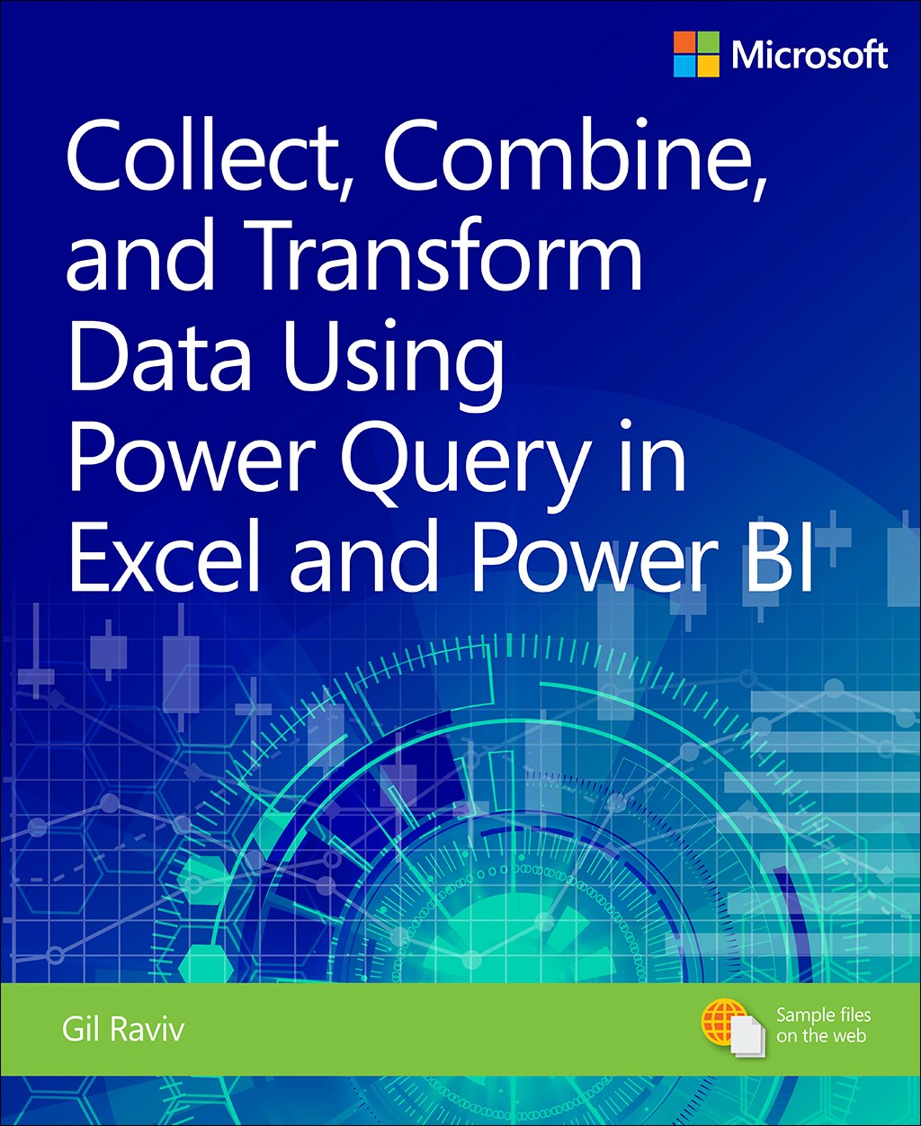
Collect, Combine, and Transform Data Using Power Query in Excel and Power BI, 1st Edition
by Gil Raviv
Human Centered Design • MDLS 2020
Notes:
This one is a real tour de force in pushing your Power Query capabilities, it will also show you Power BI stuff if you are interested in that.

Slide 80
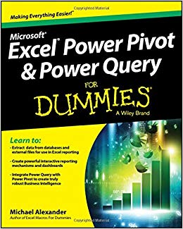
Excel Power Pivot and Power Query For Dummies,
by Mike Alexander
Human Centered Design • MDLS 2020
Notes:
This one is a little more user friendly, it focuses on Excel and you will also learn about Power Pivot as well.

Slide 81
QUESTIONS?
Notes:
Any questions on descriptive statistics?

Slide 82
II. Analyzing the data… Excel & the Analysis ToolPak

Slide 83
LESSON OBJECTIVES
Explore a dataset for research questions
Check assumptions and build hypotheses
Test formally for a difference in means between two groups
Make compelling business recommendations using inferential statistics
Notes:
Objectives for today – while we will get into some of the theory, I really want to frame what we are learning in the context of business application and know-how as possible.
So, you are able to explain in plain English the kinds of business questions that could be answered with a t-test. You can write a sound hypothesis. You can know how to size up a dataset to get a sense of the kinds of story the data can show.

Slide 84

WHY WOULD WE DO THIS IN EXCEL?
“You get to look at the data every step of the way, building confidence while learning the tricks of the trade.”
-- John Foreman
Notes:
With the rise of data science programming in R and Python it seems silly to want to do this in Excel but we can really get hands-on this way. We get a lot more up close and personal analysis of the data.

Slide 85
1. EXPLORATORY DATA ANALYSIS IN EXCEL
Notes:
Let’s begin with Exploratory Data Analysis in Excel.
Pulse check – who has heard of this term before and how would you define it? Or outside of defining it, what are some examples of it?

Slide 86

What the hey is EDA?
Preliminary understanding of variables
Classify them
Summarize them
Visualize them
Check assumptions before using them
YOU
YOUR DATA
Notes:
What do we mean by EDA? This is the first step of getting to know the data. We just want to see what we are working with and what kind of statistical analysis might be possible from the data.

Slide 87
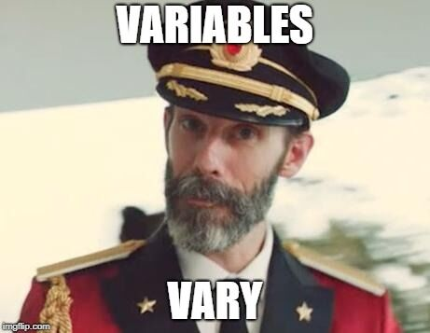
What is a variable?
Classical statistics: at least a 90%/10% split
Notes:
But before we even get into analyzing variables, let’s consider what they even are. It seems like a silly distinction but analyzing variables is what we do as analysts. For classical statistics, a variable needs to have at least a 90%/10% split to be considered a useful variable. This may seem like a trivial point, but consider something like anomaly detection where the event we are interested in may only be a one in a thousand event. This would not be a 90%/10% split, so a lot of classical statistics would have a hard time working on this problem. This is where ML/AI might come in.

Slide 88

VARIABLE TYPES AS RECIPE INGREDIENTS
Notes:
When we get a dataset, we want to see the kinds of variables we have. Think of each variable as like an ingredient. And based on those ingredients we can make different dishes. Like a “Chopped” competition.

Slide 89
WHAT’S ON THE TABLE?
Variable
Categorical
Binary
Nominal
Quantitative
Discrete
Ordinal
Continuous
Notes:
Basic overview of the types of variables:
Broad split b/w categorical and quantitative
First, categorical. For these, there are a fixed number of values that variable can take:
- In the case of binary, it’s two (yes/no, black/white)
- Nominal can have more than two, think of all 50 states, or 7 days of the week
- For ordinal, order matters, consider Freshman/Sophomore/Junior/Senior. However this corresponds to years 1, 2, 3, 4, so these can be numbers too!
Then, quantitative. These are numeric
- With a difference that with discrete, there are only a certain number of values that can be taken, for example, you can’t have 2.5 children, but we often use that as a statistical convenience, so you will see there is some wiggle room here.
- Finally, continuous – this is the one for which there can be any possible value. Height/weight/blood pressure. A lot of things in the natural world. Also money is for all intents & purposes continuous.

Slide 90
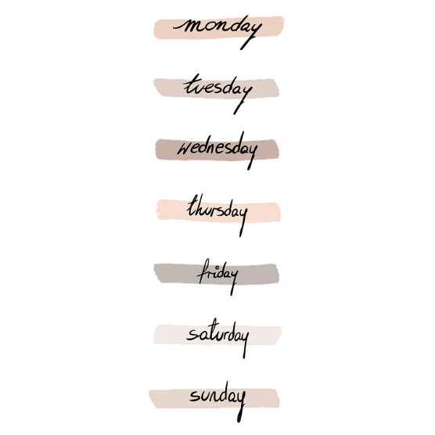


“WHICH KIND?”
Categorical
Binary
Nominal
Ordinal
Notes:
Basic overview of the types of variables:
Broad split b/w categorical and quantitative
First, categorical. For these, there are a fixed number of values that variable can take:
- In the case of binary, it’s two (yes/no, black/white)
- Nominal can have more than two, think of all 50 states, or 7 days of the week
- For ordinal, order matters, consider Freshman/Sophomore/Junior/Senior. However this corresponds to years 1, 2, 3, 4, so these can be numbers too!
Then, quantitative. These are numeric
- With a difference that with discrete, there are only a certain number of values that can be taken, for example, you can’t have 2.5 children, but we often use that as a statistical convenience, so you will see there is some wiggle room here.
- Finally, continuous – this is the one for which there can be any possible value. Height/weight/blood pressure. A lot of things in the natural world. Also money is for all intents & purposes continuous.

Slide 91


“HOW MUCH/HOW MANY?”
Quantitative
Discrete
Continuous
Notes:
Basic overview of the types of variables:
Broad split b/w categorical and quantitative
First, categorical. For these, there are a fixed number of values that variable can take:
- In the case of binary, it’s two (yes/no, black/white)
- Nominal can have more than two, think of all 50 states, or 7 days of the week
- For ordinal, order matters, consider Freshman/Sophomore/Junior/Senior. However this corresponds to years 1, 2, 3, 4, so these can be numbers too!
Then, quantitative. These are numeric
- With a difference that with discrete, there are only a certain number of values that can be taken, for example, you can’t have 2.5 children, but we often use that as a statistical convenience, so you will see there is some wiggle room here.
- Finally, continuous – this is the one for which there can be any possible value. Height/weight/blood pressure. A lot of things in the natural world. Also money is for all intents & purposes continuous.

Slide 92
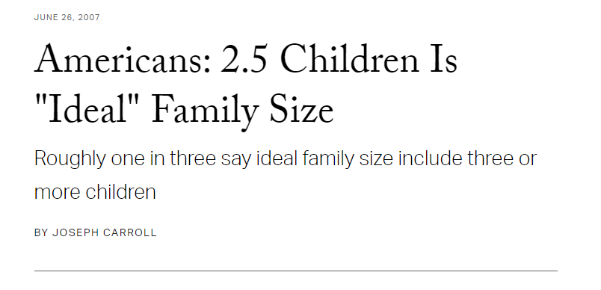
DON’T HOLD ME TO IT…
Treat discrete as continuous (maybe) when:
Large number of observations
Large number of values an observation can take
https://news.gallup.com/poll/27973/americans-25-children-ideal-family-size.aspx
Notes:
Basic overview of the types of variables:
Broad split b/w categorical and quantitative
First, categorical. For these, there are a fixed number of values that variable can take:
- In the case of binary, it’s two (yes/no, black/white)
- Nominal can have more than two, think of all 50 states, or 7 days of the week
- For ordinal, order matters, consider Freshman/Sophomore/Junior/Senior. However this corresponds to years 1, 2, 3, 4, so these can be numbers too!
Then, quantitative. These are numeric
- With a difference that with discrete, there are only a certain number of values that can be taken, for example, you can’t have 2.5 children, but we often use that as a statistical convenience, so you will see there is some wiggle room here.
- Finally, continuous – this is the one for which there can be any possible value. Height/weight/blood pressure. A lot of things in the natural world. Also money is for all intents & purposes continuous.

Slide 93
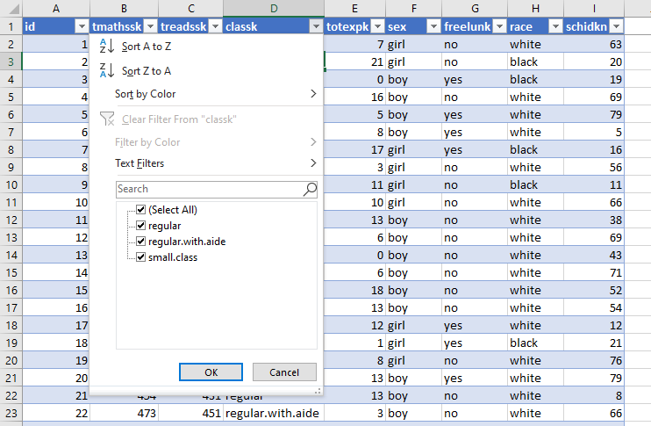
DRILL
File: star.xlsx
What type is each variable?
(Don’t be afraid to poke at the data!)
Variable | Description | Type?
tmathssk | Total math scaled score
treadssk | Total reading scaled score
classk | Type of class
totexpk | Years of total teaching experience
sex | Sex
freelunk | Qualified for free lunch?
race | Race
schidkn | School indicator
Notes:
Check out this dataset of school test scores. Consider what kind of variable you would classify as each. Make your best guess.

Slide 94
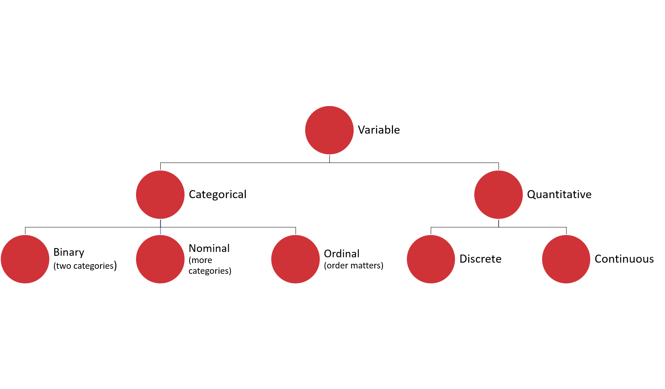
DRILL
File: star.xlsx
What type is each variable?
(Don’t be afraid to poke at the data!)
(Filtering for now…)
Variable | Description | Type?
tmathssk | Total math scaled score | Continuous
treadssk | Total reading scaled score | Continuous
classk | Type of class | Nominal
totexpk | Years of total teaching experience | Discrete
sex | Sex | Binary
freelunk | Qualified for free lunch? | Binary
race | Race | Nominal
schidkn | School indicator | Nominal
Notes:
Here is what I came up with. The first couple are more apparent, but what about things like Years of teaching experience?
That could be an ordinal variable or a discrete variable. It was also difficult to know whether race is binary or nominal, I did it for certain by placing a filter on it to see the distinct values.
Did anyone come up with other classifications and if so would you like to share them?

Slide 95

WHO KNOWS?
VARIABLE TYPES ARE CONTEXTUAL
IT’S NEBULOSE…
https://www.theanalysisfactor.com/level-of-measurement-not-obvious/
Notes:
Sometimes like in the case of the math and reading scores your variable may technically be more like a discrete variable but you can treat it more like a continuous variable. This is a fairly common occurrence. Age is a good example where it is technically continuous but for different reasons we may measure it as multinomial or discrete. I won’t spend too much time on this but if you want to learn more check out this article here which actually talks a lot about how to handle age as a variable.
Great, now we have some idea of the ingredients we are working with, although some of these ingredients are shape-shifters, but we can handle them. What do we do next?

Slide 96
Summarizing a variable: frequencies
Used for categorical variables
How many of each value do we have? (Counts)
Use PivotTables
Notes:
It’s great to look at each observation/row in isolation, but to get the “big picture” of a dataset we are going to have to summarize it.
The way we summarize a variable depends on the kind of variable it is (or at least we think it is!) If it is categorical, we can count it up.
For the demo: create a two-way cross-tab summarizing frequency counts of union/married. [Show/remind that instructions on the demo are available in the demo notes.]

Slide 97
DRILL
Demo: wages.xlsx
(Don’t forget about the demo notes)
Notes:
Let’s take an example here, and don’t forget about the demo notes!

Slide 98
Summarizing a variable: descriptive statistics
Used for continuous variables
Central tendency: what value is the variable centered around?
Mean: “average”
Median: “middle”
Mode: “most common”
Notes:
If our variable is continuous, there are quite a few ways to summarize it. We’ll start with central tendency or, what value is the variable centered around? We have a few options for measuring central tendency: mean, median and mode.

Slide 99
DRILL
You are consulting for a non-profit on fundraising strategies
Donation data is shown to the right
Which measure of central tendency (mean/median/mode) should be tracked?
Variable
10
10
20
30
100
Notes:
There is no right answer here! Just calculate the three statistics, use Excel or an online calculator if you aren’t sure what equations to use.
But again our goal is business impact here so we want to tie these measures to real business use cases.
Leave your thoughts in the chat as to what the important variable is.

Slide 100
DRILL
You are consulting for a non-profit on fundraising strategies
Donation data is shown to the right
Which measure of central tendency (mean/median/mode) should be tracked?
No one statistic rules them all
Variable
$10
$10
$20
$30
$100
Statistic | Value
Mean | $34
Median | $20
Mode | $10
Notes:
It depends what you want to track!
The average donation is perhaps inflated by the $100, and that is a big downside of using the average.
That is why the median can be more revealing as it is more reflective of a true “middle ground” which is also important to know.
Finally, you might want to know what the most common donation is, that would be the mode.
So, they are all important!
But, usually we are going to analyze the mean because that is more receptive to advanced analysis, you’ll see that if data is normally distributed, then the mean will be the most revealing measure for us.
You will also see from this example the importance of having enough data! Kinda hard to know what’s going to be important with only five observations!

Slide 101
Summarizing a variable: descriptive statistics
Variability: how spread is the variable from the center?
Range: What are the min/max?
Variance: Relative to the mean, how far away does the data fall?
Standard deviation: Square root of the variance
Notes:
Now that we have established where the “center” of the variable is, we can explore how “spread” the variable’s values are from the center.
The most basic measure for this is the range or the min/max.
Then there is the variance and the standard deviation – these are more sophisticated measures of how far a value falls on average, relative to the mean.
Standard error – how much variation can we expect in our means if we drew many random samples.

Slide 102
INSTALLING THE ANALYSIS TOOLPAK
Notes:
Has everyone done this? If not, check the demo notes and/or follow along with the next two slides.
The steps are different for Mac versus Excel.

Slide 103
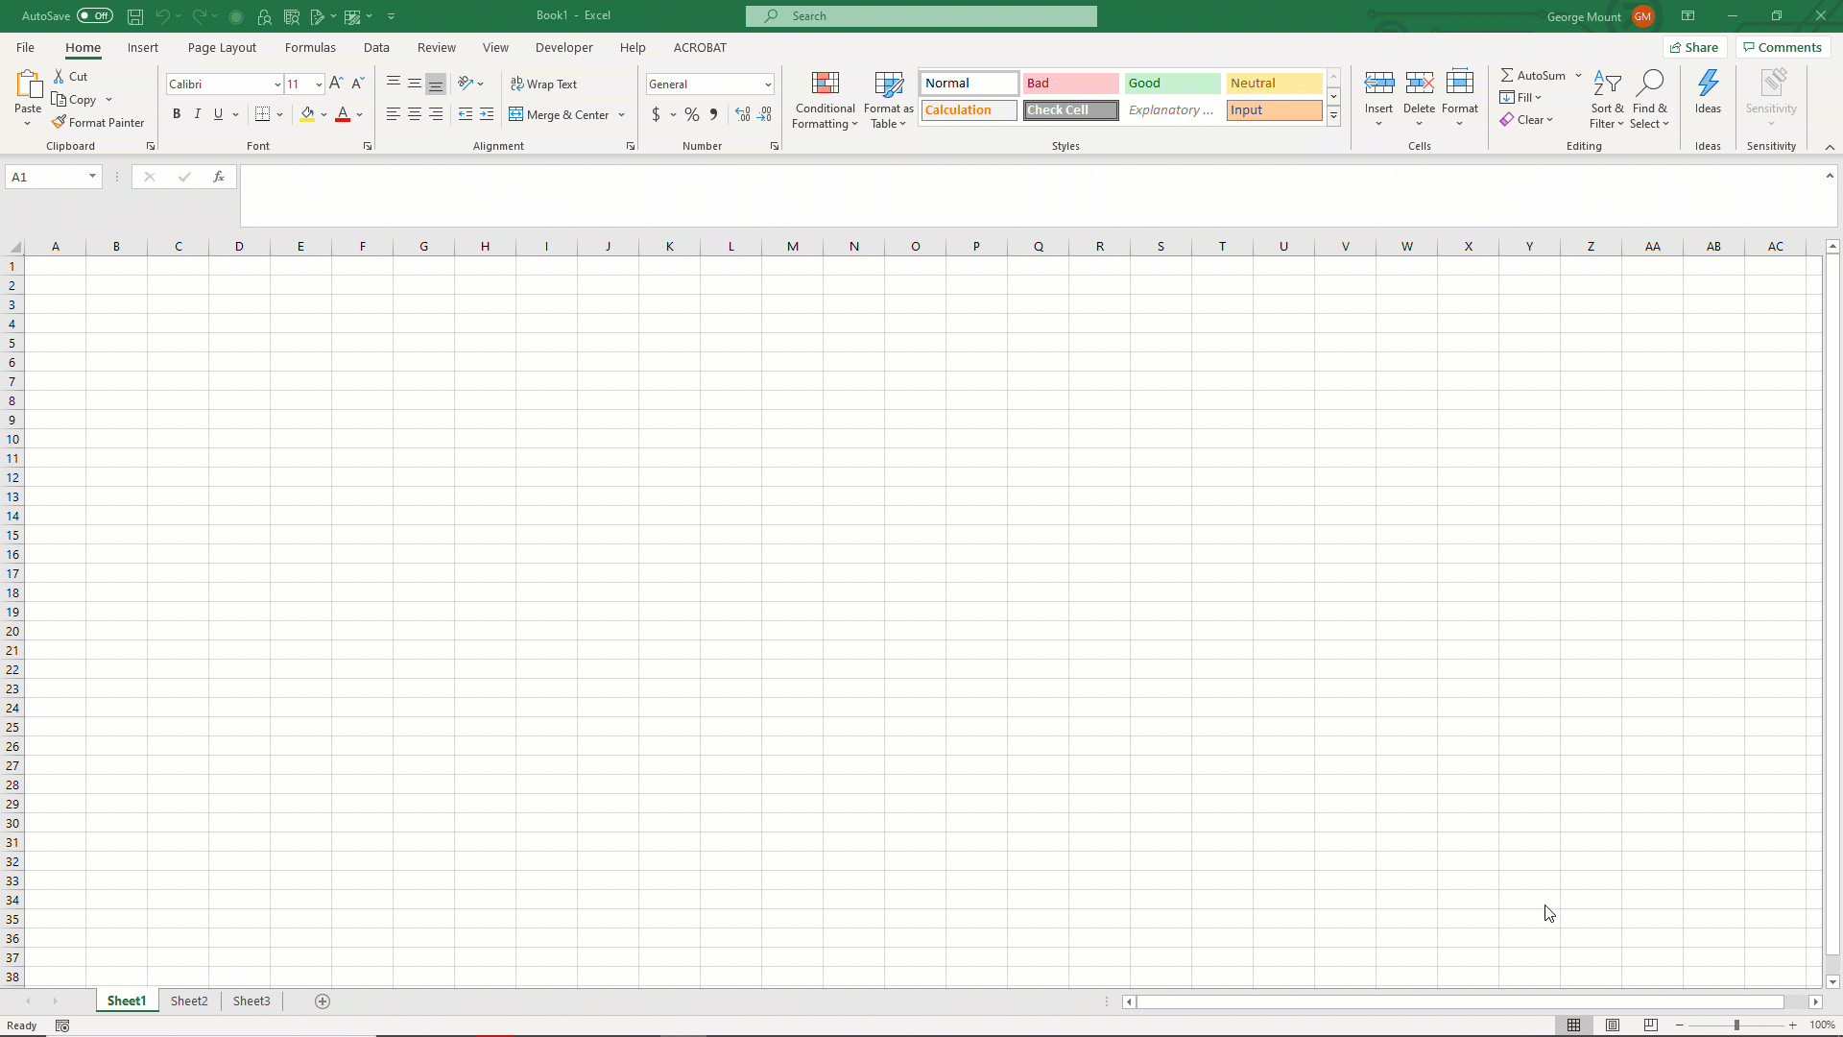
ON WINDOWS:
File → Options → Add-ins
Click Go toward the bottom of the menu
Select Analysis ToolPak from the menu
Click OK
It is not necessary to select the Analysis ToolPak–VBA option

Slide 104
DEMO
File: wages.xlsx
Summarize wage with the Analysis ToolPak
Notes:
Give me a thumbs up when everyone has this installed.
Open up the wages dataset, we will now summarize a continuous variable (wage) using the Analysis ToolPak.
Another reminder to use the demo notes.

Slide 105
Summarizing a variable: visualization
Histogram
What does the data’s distribution “look like?”
How many data points lie with each bin?
Notes:
Getting the measures of skewness/kurtosis is great but there’s nothing quite like a picture! Let’s draw the actual visualization with a histogram.

Slide 106
DEMO
File: wages.xlsx
Visualize wage with a histogram
Notes:
Let’s do it!

Slide 107
DRILL
File: housing-descriptive.xlsx
Explore this dataset:
Choose a categorical variable and run its frequencies
Choose a continuous variable, run its descriptives and plot a histogram
Notes:
Now it’s your turn to do each of the three steps.
This is a real life dataset on housing prices. Do some EDA on this data.

Slide 108
QUESTIONS?
Notes:
Any questions on descriptive statistics?

Slide 109
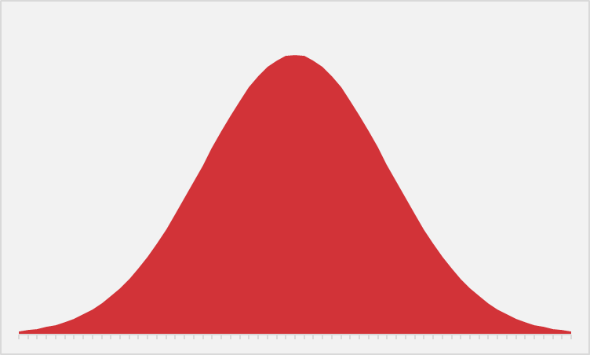
EVER WANTED TO JUST BE NORMAL?
STATISTICS IS YOUR CHANCE.
Notes:
The normal distribution of paramount in statistics. We are able to extrapolate pretty well about a variable’s value when it falls on a bell curve because we know exactly how “spread” the variable’s values are around its center.
Next slide for some specifics.

Slide 110
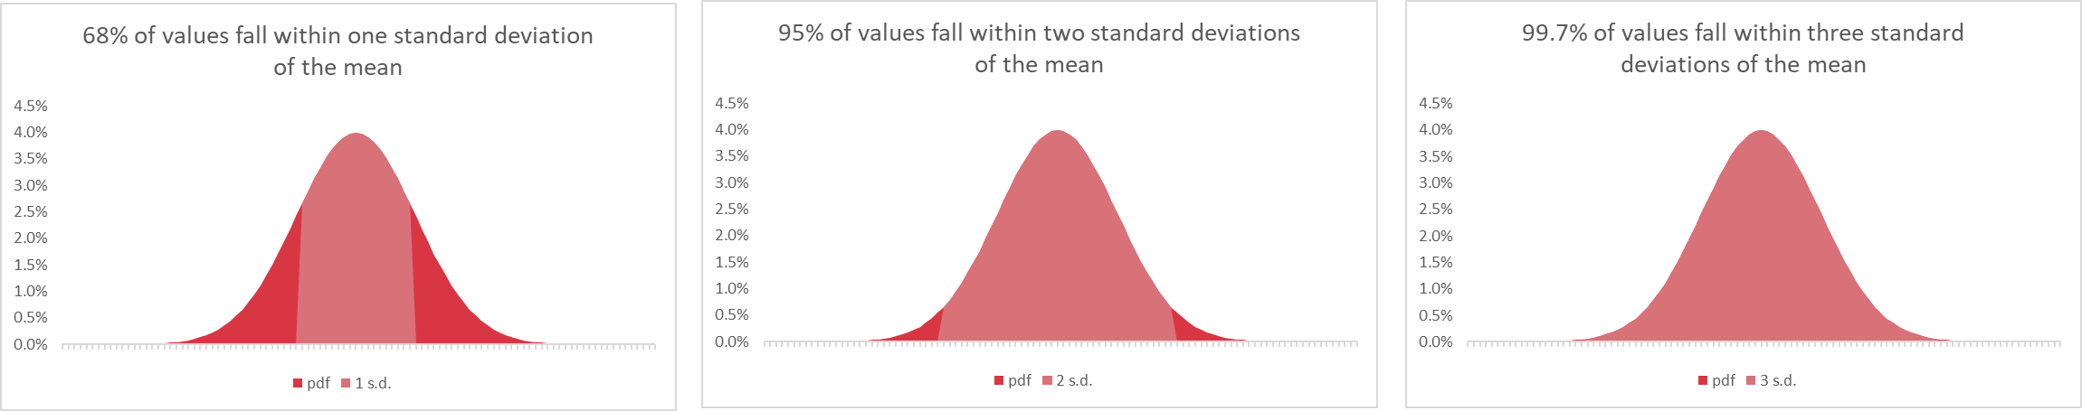
WHAT DOES IT MEAN TO BE NORMAL?
“Empirical rule”
https://www.katemarshallmaths.com/chapter-3-bell-shaped-distribution.html
Notes:
This is called the empirical rule and it tells us how many observations we expect to fall within how many standard deviations of the mean. We can expect that 68% of our observations fall within 1 standard deviation, 95% within 2, and 99.7% within 3. This allows us to state how likely or unlikely it is to get any certain value.

Slide 111

SPOTTING NORMAL DISTRIBUTIONS
There are no “perfectly” normally distributed variables, but some are more normal than others:
Descriptives: skewness ± 8, kurtosis ± 20
Visualizations: does it “look” normal?
Inferentially: is it statistically distributed differently than normal?
https://www.katemarshallmaths.com/chapter-3-bell-shaped-distribution.html
Notes:
https://pixabay.com/photos/bigfoot-evolution-anthropoid-ape-542546/
The interesting thing about the normal distribution is that while we see approximations to it everywhere, it’s nearly impossible to find it perfectly in real life. Some ways we can check whether a variable is normally distributed enough are with descriptive statistics. We can check whether its skewness and kurtosis fall within a certain range, this is a pretty generous range here, but a perfectly normal distribution will have a skewness and kurtosis of 0, so the closer to 0 the more normal it is.
We can also visualize it and we’ve been using histograms to do that. With this we can see whether the variable “looks” normal, or how “bell-shaped” it appears.
Finally there are some other ways to test normality but we won’t get into those, we can perform a statistical test to check whether our variable is likely to be different than normal. The cool thing is that after this course you will understand how tests like these work at a basic level.

Slide 112

STATROULETTE
A roulette wheel returns values between 0 and 36.
Let’s simulate a game of roulette in Excel
Notes:
Instructions follow on the next slide.

Slide 113
DEMO
Simulate 500 rounds of a roulette spin.
Plot the resulting frequency distribution.
Notes:
More instructions on next slide.
Ask if anyone knows what formula to use for this.

Slide 114
DEMO
Simulate 500 rounds of a roulette spin using RANDBETWEEN(0,36)
Plot the resulting frequency distribution using a histogram
Hit F9 while in your workbook. What happens?
Notes:
Resulting screenshot to be shown on next slide.
If you need help with the plotting, go to the older demo notes, that’s what we did before.
Don’t look ahead in the slides!

Slide 115
DEMO
Now, simulate a roulette spin 100 times.
Take the average spin.
Do this 500 times.
Plot the distribution of sample means
Solution: stat-roulette.xlsx
Notes:
Now we will take the average roulette spin after spinning 100 times. Do this 500 times and plot the histogram of the average spins. What happens this time?
Don’t look ahead in the slides!

Slide 116

MAGIC… OR STATISTICS?
Central limit theorem: the sampling distribution of the mean of any independent, random variable will be normal or nearly normal, if the sample size is large enough.
Notes:
Magic, or statistics? This is courtesy of the central limit theorem. Sample means tend to normality, which means since we know the probability distribution, we can make reliable estimates about a population, given a sample, as we extrapolate to that population.

Slide 117
How “large enough” is large enough?
N = 30? 60? 100?
It depends on how “normal” your sample is
Notes:
The big caveat is that a sample has to be “large enough.” What does that mean? Well, the base case is 30. 60 is better and 100 is even better. If your data’s sample is already looking normal, it’s going to take a smaller sample size to hit that “large enough” qualification. So generally a normally distributed variable is considered a requirement to do these statistics in practice, whereas in theory this is not such a dead-locked requirement.

Slide 118

MEET ME IN THE MIDDLE
A roulette wheel returns values between 0 and 36.
What is the average roulette spin given more and more spins?
Notes:
https://unsplash.com/photos/3qMOyoqI-JM
Instructions follow on the next slide.

Slide 119
DEMO
large-numbers.xlsx

Slide 120
MAGIC… OR STATISTICS?
Law of large numbers: the average of results obtained from trials become closer to the expected value as more trials are performed
Notes:
Magic, or statistics?

Slide 121
QUESTIONS?
Notes:
Ok, let’s end our EDA module on the Central Limit Theorem as you’ll see it’s the “missing link” between descriptive and inferential statistics.
We are done with the first module! Any questions?

Slide 122
2. FOUNDATIONS OF INFERENTIAL STATISTICS
Notes:
In this module we will begin to take what we’ve learned about our sample data, and how sample means behave, and put those together to start making inferences about a population based on a sample.

Slide 123
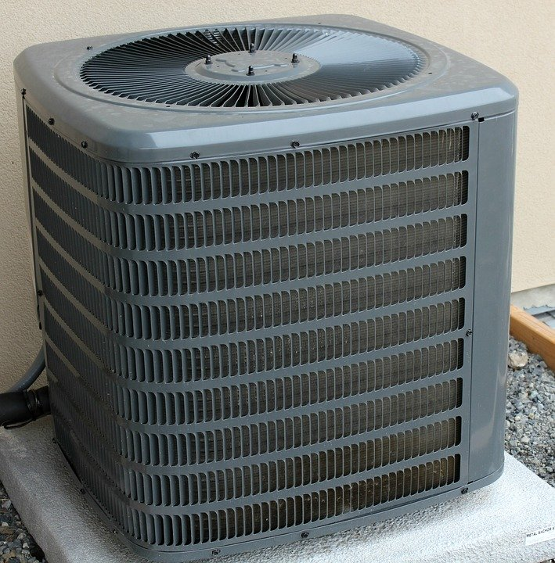
HOUSES WITH AIR CONDITIONING ARE BETTER THAN THOSE WITHOUT
Notes:
Again, I really want to focus this on real-life business applications so this is not some academic undertaking, so let’s say that we are real estate analysts and we want to consider what kinds of features on a house help.
We might start with a claim like this. I don’t think anyone would disagree with this statement, but how would we actually quantify that? What can we measure to compare a difference in quality between houses with and w/o air conditioning?

Slide 124
HOUSES WITH AIR CONDITIONING ARE BETTER HAVE HIGHER SALES VALUES THAN THOSE WITHOUT
Notes:
Price! Price is a readily quantifiable value that could stand in for quality that I think a lot of business managers would be pleased with learning more about. Do homes with AC sell for a higher value? Now we are talking business.

Slide 125
HOUSES WITH AIR CONDITIONING ARE BETTER HAVE HIGHER SALES VALUES THAN THOSE WITHOUT, ON AVERAGE
Notes:
But let’s qualify further, how are we going to compare housing prices? Well, we could ask on average whether homes with AC sell for higher. Now we are making a readily measurable claim.

Slide 126
HOUSES WITH AIR CONDITIONING HAVE HIGHER SALES VALUES THAN THOSE WITHOUT, ON AVERAGE, GIVEN THE SAMPLES WE HAVE
Notes:
Of course, we can’t measure the sale price of EVERY house, we are going to take a sample. So we need to be very specific about what we are measuring.
However you are going to find that through some of the principles you learned earlier that we can actually make some claims about ALL houses given a SAMPLE of houses that we took.

Slide 127

THE AVERAGE VALUE OF ONE CATEGORY IS HIGHER THAN ANOTHER
(Independent samples t-test)
Notes:
Let’s think about what we just did here, essentially we are looking for a difference in the average of some continuous variable between two categories. Going back to our analogy, with these two ingredients we can make the “recipe” of an independent samples t-test.
Before we run the test, we want to fully explore the variables we are going to test. This is like measuring out our ingredients to make sure the recipe is right.

Slide 128

DEMO
File: housing-foundations.xlsx
Is there a difference in sales price for homes with air conditioning (airco)?
Find the descriptive statistics and plot the histograms for each category
Notes:
So, using the tools we’ve learned so far (frequencies, descriptive statistics, histograms), let’s see what we can learn about a difference in means between homes w/ and w/o AC.

Slide 129

DRILL
File: housing-foundations.xlsx
Is there a difference in sales price for homes with a full, finished basement (fullbase)?
Save your work – you’ll “build on” it later!
Notes:
Photo source: https://unsplash.com/photos/T-br3SYp9kw
Now it’s your turn to follow the steps taken so far.
“Build on” is a pun :P

Slide 130

We have the data… just not all of the data
There is a difference across 546 homes…
… but what about all homes?
Is our sample reflective of their populations?
Notes:
https://unsplash.com/photos/iuqxv7kFj64
So, we were able to compare the means between the two samples, but we want to check that what we’ve found in the data is not a fluke, there are a lot more than 546 houses, we want to know whether this story can be told for ALL homes, not just the homes we have measured. So how are we going to do that?

Slide 131

… but that doesn’t stop your phlebotomist!
Or your pollster
Or your QA manager
Or your real estate analyst 😉
Notes:
https://pixabay.com/photos/laboratory-analysis-diagnostics-2815639/
To think about how this would work, consider that when you get a blood lab done, you aren’t offering ALL of your blood! A phlebotomist can take a pretty tiny amount of blood and then the lab is able to generalize those results to your entire body.
Pollsters do the same thing, with a relatively small sampling are able to predict for populations (to middling effect sometimes 🤷‍♂️)
We can use these same principles to analyze real estate!

Slide 132

GETTING RIGOROUS WITH A HYPOTHESIS
Testable
Falsifiable
Burden of proof on the claimant
Notes:
Now we want to move from asking, “Do houses with air conditioning have higher values than those without?” to an actual hypothesis. A good hypothesis will meet a few criteria:
First, it must be testable. We’ve already done a good job with that by making sure we can gather and measure the data used for this problem.
Related to that it should also be falsifiable, we should be able to get a clear “yes or no” result from the hypothesis.
Finally, the burden of proof of a hypothesis is on the claimant – think about a courtroom, where a suspect is innocent until proven guilty. We need to “start from the status quo.” So in the analysis we are conducting, the burden of proof is on us to show that there is a difference in means, the status quo would be that there is no difference.

Slide 133
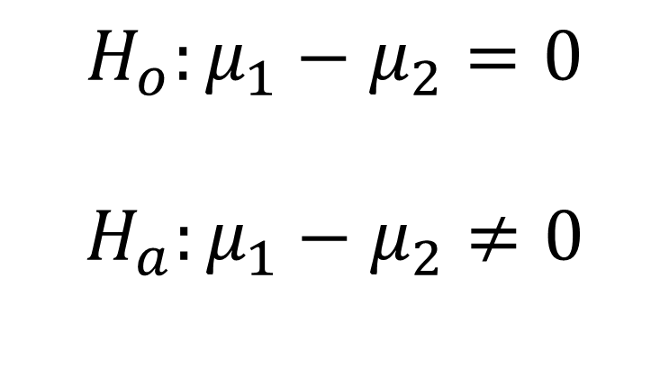
GETTING RIGOROUS WITH A HYPOTHESIS
Null hypothesis: no difference in population means
$$H_{o}:μ_{1}−μ_{2}=0$$
$$H_{a}:μ_{1}−μ_{2}≠0$$
Alternative hypothesis: some difference in population means
Notes:
Hypothesis testing is rigorous, so we’ll even translate this into math-speak! Here the mu-1 and mu-2 indicate population means 1 and 2. Yes, we are talking about the ENTIRE “population” of homes, not just the “sample” of homes we have collected. The “status quo” is that there is no difference, and it’s up to us to provide evidence to the contrary.

Slide 134
… but we don’t know the population means…
Central limit theorem to the rescue!
Infer the population mean (which is normally distributed) given a sample mean…
... Some uncertainty required.
Usually 5%
Notes:
How can we talk about the population means, when we don’t know the population means? We can do so because we can infer a population’s mean, given a sample mean, because of the fixed probability distribution of the sample means.
Still, this is speculative, we don’t know the population’s mean! So some “guessing” or uncertainty is required. We need to pick some level of uncertainty that we are comfortable with. Generally this is 5%. We’ll use this level too.

Slide 135
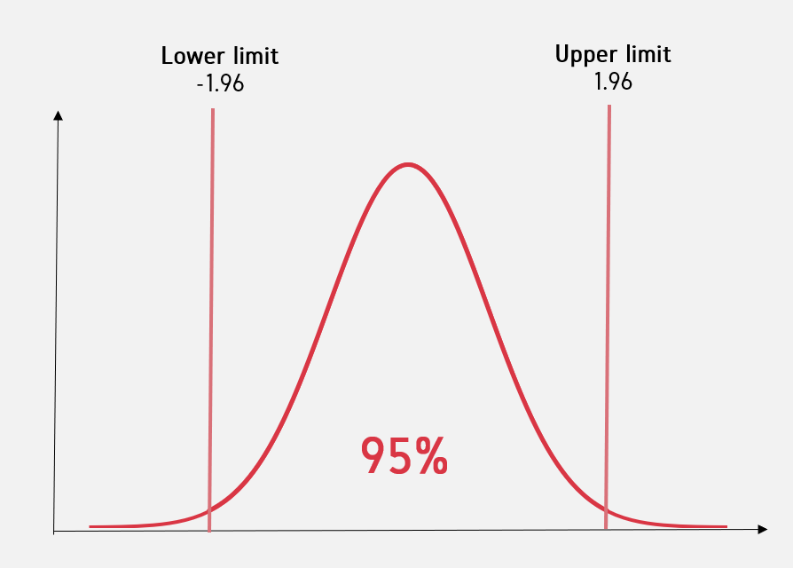
Critical value
Notes:
Okay, so let’s look at a picture of what this all actually means. Imagine we have the distribution of sample means. Based on our sample we can infer some likely boundaries within which the population mean would be. 95% is usually the “likely bounds” we choose. Outside this range, we would say that it’s unlikely to find this sample mean among the population. This “make-or-break” boundary is known as the “critical value” and for the 95% confidence interval it will be 1.96. We will calculate a test statistic and if it falls outside of the +/- 1.96 range than it’s considered a statistically significant value.
So, how do we come up with all these calculations? The test statistics and all that? Well, that will require some math, so buckle up.

Slide 136
EXPLICIT WARNING:
MATH AHEAD
Notes:
Brace yourselves!

Slide 137
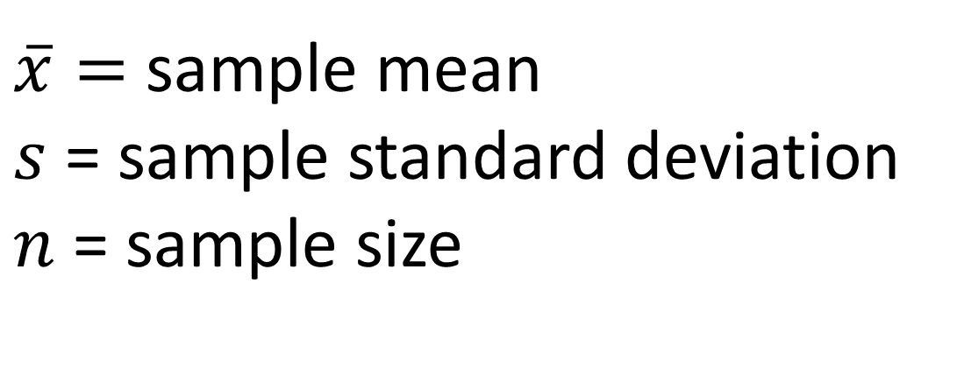
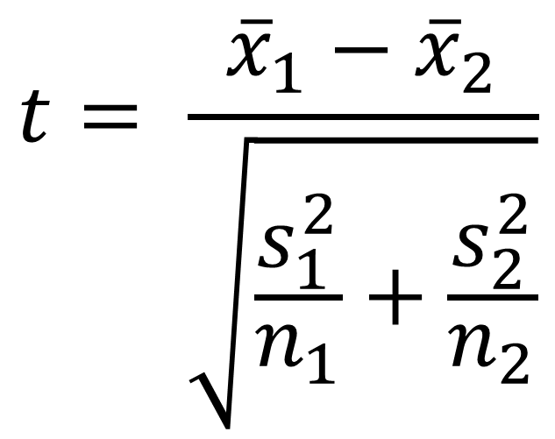
Calculating the test statistic
$$t= \frac{{\overline{x}}_{1}−{\overline{x}}_{2}}{\sqrt{\frac{s_{1}^{2}}{n_{1}}+\frac{s_{2}^{2}}{n_{2}}}}$$
$\overline{x}=$ sample mean
$s$ = sample standard deviation
$n$ = sample size
Notes:
Here is how we test the test statistic for an independent samples t-test. Remember, we want to know if a difference in means is likely to be found in a population, given a sample.
If this resulting value exceeds +/- 1.96, then it’s significant.

Slide 138
Does the test score exceed the critical value?
Yes: Reject the null. There is likely to be a significant difference in means.
No: Fail to reject the null. There is unlikely to be a significant difference in means.
Two-tail t-test
Notes:
If a test statistic exceeds the critical value, then we would reject the null.
Otherwise, we fail to reject the null.
Notice the delicate language here?

Slide 139

In statistics, nothing is proven, everything is falsifiable.
Notes:
Again, we don’t actually know the population values! So we can’t say for certain what is what! We can only infer population means, given our sample means, and the magic of the central limit theorem.

Slide 140
QUESTIONS?
Notes:
Any questions about the “hypothetical” stuff here so far? (lol)
Don’t get too hung up on this part, it will make more sense in action when we actually begin to crunch the numbers in Excel.

Slide 141
3. T-TESTS FOR BUSINESS IMPACT
Notes:
We’ll do that now in this section, again with the emphasis on driving some business impact on what we are doing.

Slide 142
WARM-UP
We want to test for a significant difference in sale price between houses with and without air conditioning.
What are our hypotheses?
Notes:
It’s good practice to write out the hypotheses we are going to be testing.
If we are using the Greek notation, they will be the same notation each t-test ☺

Slide 143
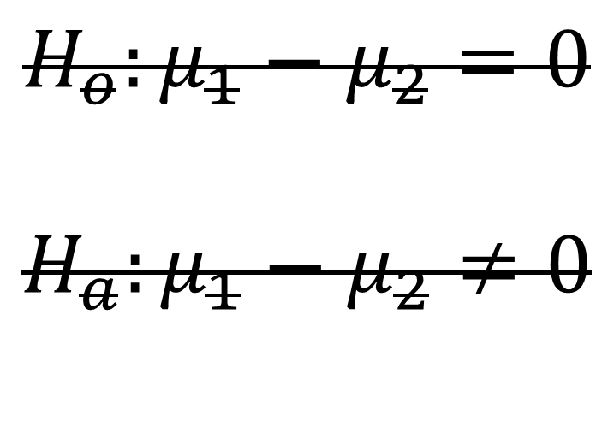
WARM-UP
We want to test for a significant difference in sale price between houses with and without air conditioning.
What are our hypotheses?
$$H_{o}:μ_{1}−μ_{2}=0$$
$$H_{a}:μ_{1}−μ_{2}≠0$$
Null hypothesis: there is no difference in the average sale price of homes with and without air conditioning.
Alternative hypothesis: there is a difference in the average sale price of homes with and without air conditioning.
Notes:
It’s good practice to write out the hypotheses we are going to be testing.
If we are using the Greek notation, they will be the same notation each t-test ☺

Slide 144
DEMO
File: housing-inferential.xlsx
Is there a significant difference in sales price for homes with air conditioning?
Notes:
So, we analyzed the sample data, now let’s check for a “generalizable” difference based on these samples. This is “statistical significance.” Follow along and check the Demo Notes later.

Slide 145
DRILL
File: housing-inferential.xlsx
Is there a significant difference in sales price for homes with a full, finished basement?
Save your results for later!
Notes:
Your turn to walk through a t-test.

Slide 146
DEMO -- SUMMARY
Two-tailed independent samples t-test
95% confidence = critical value of 1.96 = p-value of .05
p < .025
p < .025
Notes:
So, we analyzed the sample data, now let’s check for a “generalizable” difference based on these samples. This is “statistical significance.” Follow along and check the Demo Notes later.

Slide 147
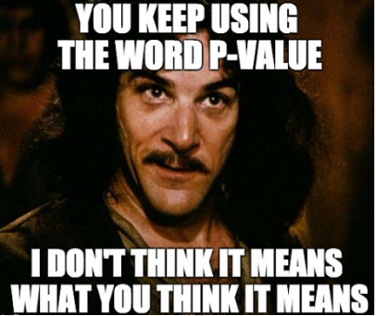
A p-value is NOT a probability of making a mistake.
A p-value is the probability of obtaining an effect at least as extreme as the one in your sample data, assuming the null hypothesis is true.
Notes:
So, we calculated the p-value and found significance, but what did we actually find here? It is NOT the probability of making a mistake, it is a measure of how likely it would be to find the observed difference in means, if there were actually no difference in population means.
Let’s walk through some p-value interpretations on the next slide.

Slide 148
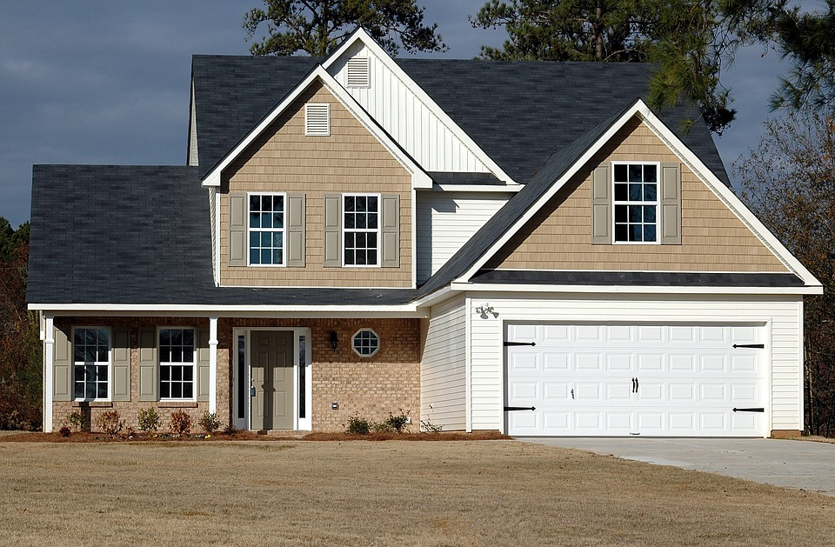

SOLD: $200,000
SOLD: $200,000
If this were true in the population, you’d have found this in < .005% of samples due to random error.
Notes:
Your turn to walk through a t-test.

Slide 149
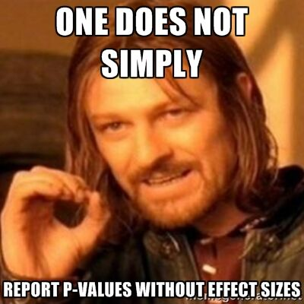
A p-value is NOT a substantive measure.
A p-value does not tell you how much of a difference there is, only that there is likely to be a difference.
The confidence interval will give us a substantive measure.
Notes:
A p-value also doesn’t tell us how BIG the difference/effect is. It would stand to reason that the lower the p-value, the bigger the actual difference in means, but this isn’t necessarily true. If we want to know the actual bounds within which we are assuming the population means to fall, we would want to calculate the confidence interval.
It’s a good idea to calculate the confidence interval! Unfortunately many statistical programs such as Excel and Python do not give you the confidence interval by default. (R does!) so we will have to take it into our own hands. Don’t become overly dependent on the p-value!

Slide 150
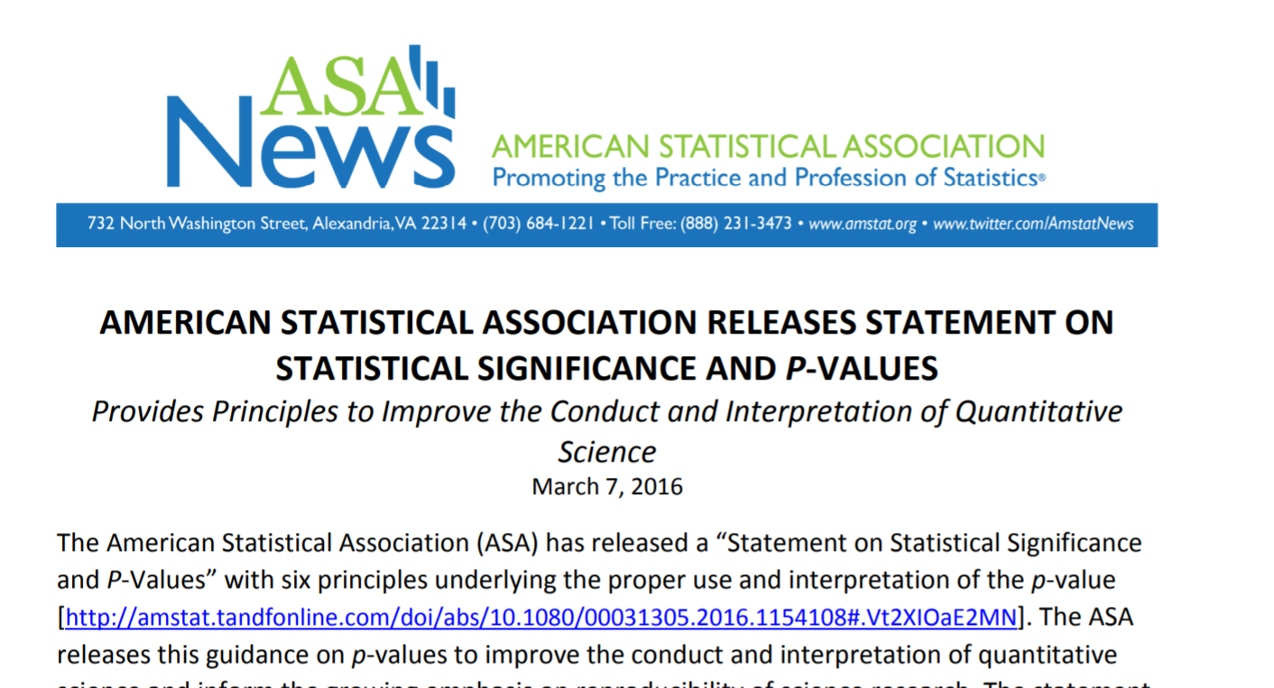
ONE STAT TO RULE THEM ALL TRIANGULATE
Confidence interval: translate the statistical results back into the original measurement unit
What range of values are we expecting with 95% confidence?
https://www.amstat.org/asa/files/pdfs/P-ValueStatement.pdf
Notes:
Again, the p-value is not the be-all and end-all of statistical analysis! Too often it has become that, a threshold to qualify for publication, funding, etc, but the ASA has taken some steps away from this, because we want a more holistic data analysis.
A little more math here, everyone ready? So we can actually calculate the confidence interval, since it’s important too!

Slide 151
DEMO
File: housing-ci.xlsx
Calculate the confidence interval for difference in prices for homes with air conditioning
Notes:
We will continue in our analysis of air conditioning & prices, again the confidence interval is not included with the ToolPak so we will have to crunch these numbers ourselves.

Slide 152
DRILL
File: housing-ci.xlsx
Calculate the confidence interval for difference in prices for homes with a full, finished basement
Notes:
Now it’s your turn to build on your analysis from the last drill.

Slide 153
DEMO
File: margin-of-error.xlsx
Why do pollsters report a “margin of error?”
Why is it usually 2-3%?
Notes:
We will continue in our analysis of air conditioning & prices, again the confidence interval is not included with the ToolPak so we will have to crunch these numbers ourselves.

Slide 154

PRESENTING T-TEST RESULTS FOR BUSINESS IMPACT
Methods are not stories
Translate to the universal denominator … $
“The results were significant at p < .005” or
“With 95% confidence, a house with AC sells for between $6K and $15K more.”
When in doubt, visualize it
Notes:
That’s great but what about actually taking this analysis to your boss? I don’t think a lot of bosses would want to hear about what your test statistic was and what critical value you used. You instead want to tell some cohesive story about the data analysis.
Now this is not a class about storytelling with data, and there are some OLT classes that would help with this, but I know one thing that always tells a good story to managers is MONEY. Money talks, right? So the most you can bring your analysis into actual money, the better.
Finally, when in doubt with how to drive home a data story, it’s never a bad idea to visualize your results, so let’s do so with a t-test.

Slide 155
DEMO
File: housing-viz.xlsx
Visualize the difference in average sales price for homes with air conditioning
Notes:
Let’s continue with our AC analysis by drawing a picture of the results.

Slide 156
DRILL
File: housing-viz.xlsx (continued)
Statistically test and visualize the difference in average sales price for homes with gas for hot water heating, gashw (Note: new variable!)
Notes:
Now it’s your turn – notice this is a new variable!
This is your chance to run the whole analysis – from descriptives by category to visualization.
Parts of this analysis are going to look funky, which was intended ☺

Slide 157
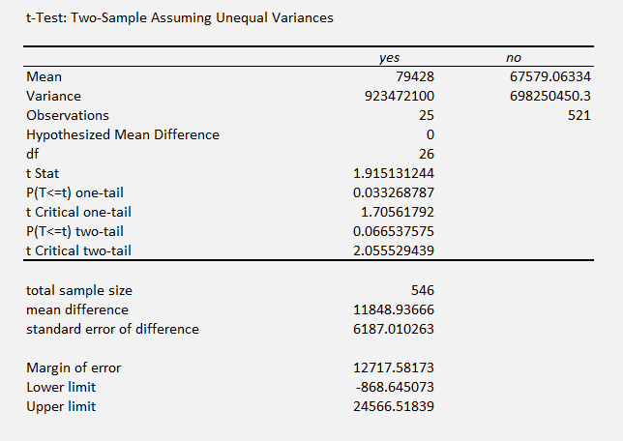
It’s your world, the data is just living in it
A p-value has wiggle room
A confidence interval communicates what’s at stake
A larger sample size can lead to more robust results
CASE
WHEN condition THEN result-expression
WHEN condition THEN result-expression ...
ELSE result-expression
END AS alias
Notes:
Here is an interesting analysis. There doesn’t appear to be a difference in prices of homes with gas heating, but our sample size of Yes’s is only 26! And guess what, we are looking at a swing of between -$900 and $24,500. So I wouldn’t reject this out of hand just because it’s a .06 p-value. I would want to get a little more Yes data to make this relationship a little more clear.
So, this analysis is just a guide, it’s not the be-all, end-all!

Slide 158
QUESTIONS?
Notes:
We are done with t-tests, any questions!
On to the conclusion.

Slide 159
4. CONCLUSION

Slide 160
Future learning
Check the 4-conclusion folder for additional t-test practice
Experimental design & A/B testing
Testing multiple categories/non-normal categories/the same observations at multiple time points
Linear regression
Notes:
To continue learning, a few options:
First, I have collected some datasets that have the right “ingredients” in them for a satisfying t-test, have at them!
Second, what we really didn’t get into was how to sample this data to come up with reliable results in the first place. This gets into concepts like sampling bias and more broadly experimental design. This seems like it would be rather academic but actually is a pretty valuable business skill to have especially in the context of A/B tests.
We’ve also only scratched the surface of inferential statistics, that is, comparing the means of two somewhat normally-distributed categories, there are quite a few other tests to be aware of, again “different recipes for different ingredients.”
Finally the linear regression is the Mac-daddy of classical statistics and in many ways is a link between classical statistics and more modern machine learning techniques.
A couple of books that are on OLT which will help you on this learning path:

Slide 161
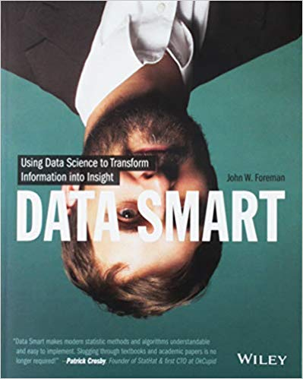
Data Smart: Using Data Science to Transform Information into Insight,
by John Foreman
Human Centered Design • MDLS 2020
Notes:
This is a more “modern” approach to statistical analysis in Excel and will show you techniques like clustering, naïve Bayes, and things that you might not have thought possible in Excel, but again by learning them in Excel you get a really hands-on look at how these algorithms work that you may not necessarily get in R or Python (I quoted from this book way at the beginning in explaining why we would want to learn this stuff in Excel!)
The final chapter of this book does show you how to move into R from spreadsheets which is not a bad idea when you want to “productionize” what you have learned, but spreadsheets are really an awesome learning tool.

Slide 162
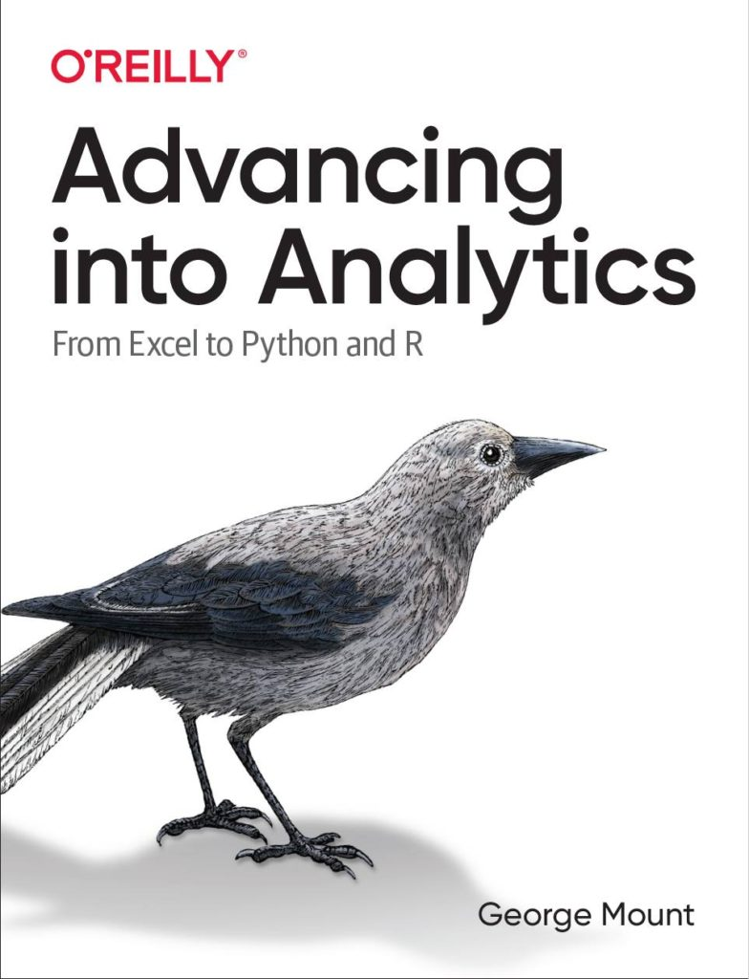
Advancing into Analytics: From Excel to Python and R,
by George Mount
Human Centered Design • MDLS 2020
Notes:
This is a more “modern” approach to statistical analysis in Excel and will show you techniques like clustering, naïve Bayes, and things that you might not have thought possible in Excel, but again by learning them in Excel you get a really hands-on look at how these algorithms work that you may not necessarily get in R or Python (I quoted from this book way at the beginning in explaining why we would want to learn this stuff in Excel!)
The final chapter of this book does show you how to move into R from spreadsheets which is not a bad idea when you want to “productionize” what you have learned, but spreadsheets are really an awesome learning tool.

Slide 163
QUESTIONS?
Notes:
Any final questions?

Slide 164
III. Augmenting & automating your knowledge: Excel to Python (and back)

Slide 165

Lesson objectives
Python and Excel: yes, and
Breaking through with Python
Automating with Python
Agenda:
Use cases
Five things to know
Demo
Notes:
So this means anyone is free to build on it or redistribute it… and that’s how we’ll get our code

Slide 166
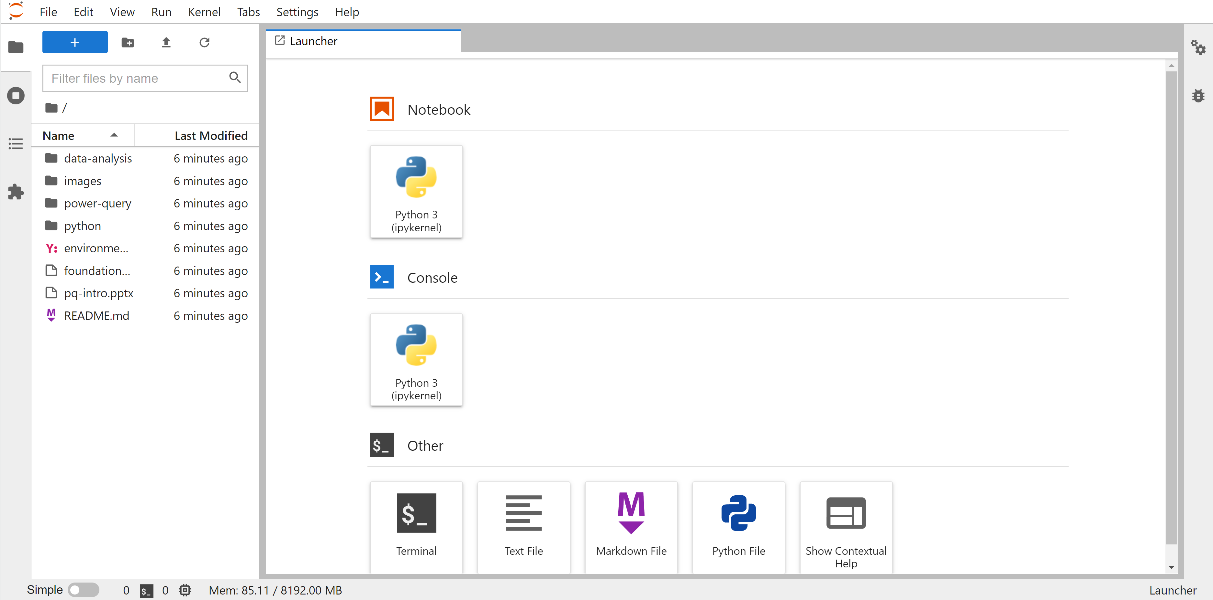
Follow along
https://swiy.co/mv-python
Cloud-based Python session, no downloads needed
Restart your browser if you have issues
Notes:
So this means anyone is free to build on it or redistribute it… and that’s how we’ll get our code

Slide 167


Where are these tools letting you down?
Does Power Query and the ToolPak handle it?
What else is available?
Notes:
Because PQ and the Toolpak can handle a lot. Otherwise Microsoft wouldn’t have build them. But at the same time Python can handle a lot otherwise that wouldn’t be under development.

Slide 168

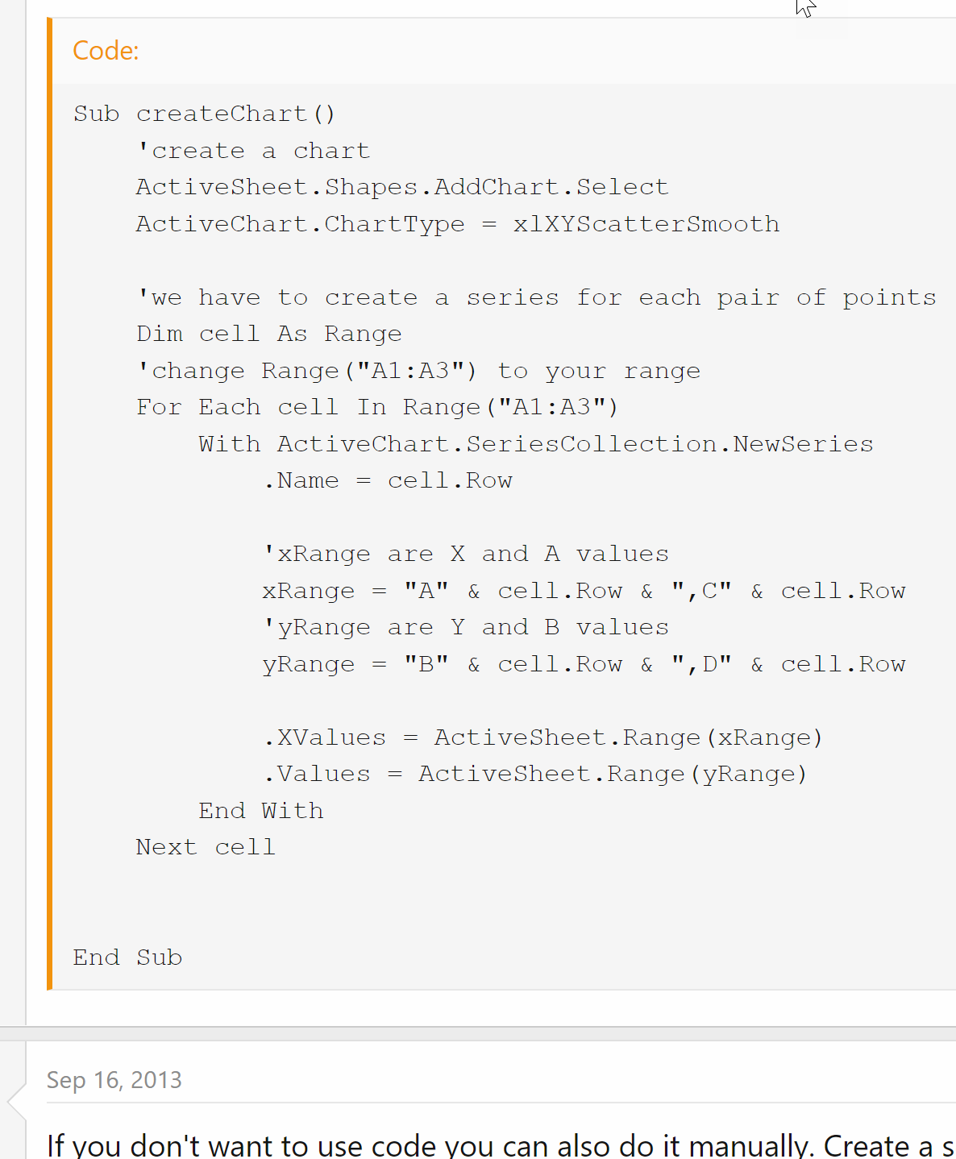
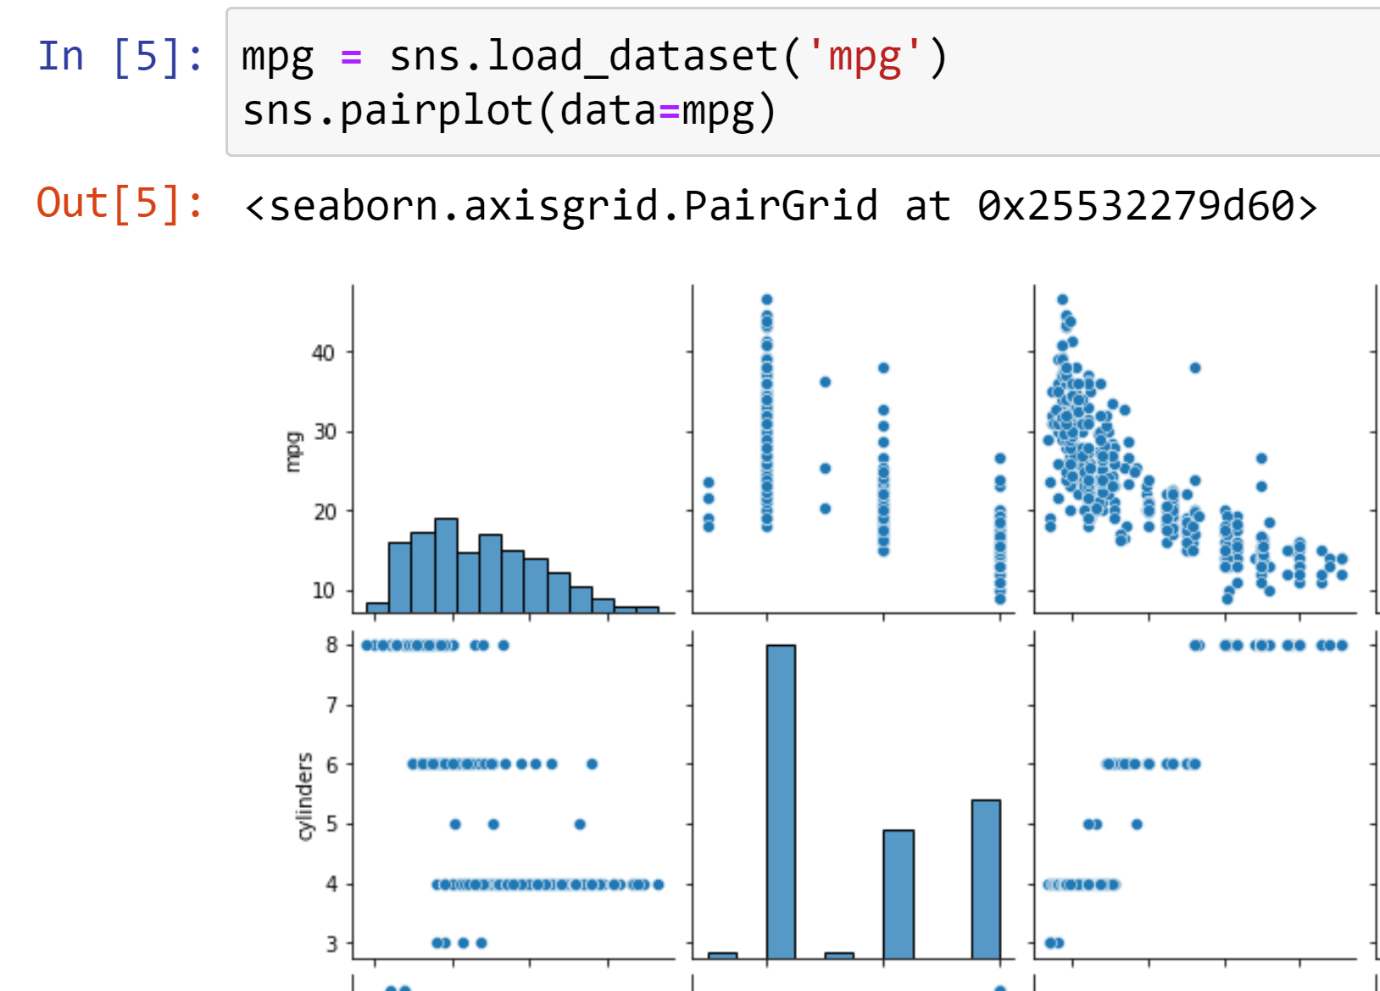
“I want to make a scatterplot for every pair of variables”
https://www.mrexcel.com/board/threads/excel-2010-plot-lines-between-multiple-ordered-pairs.726760/
https://gist.github.com/summerofgeorge/cb214a5c350c378b2107c5cc6385e73f
Notes:
So this means anyone is free to build on it or redistribute it… and that’s how we’ll get our code

Slide 169
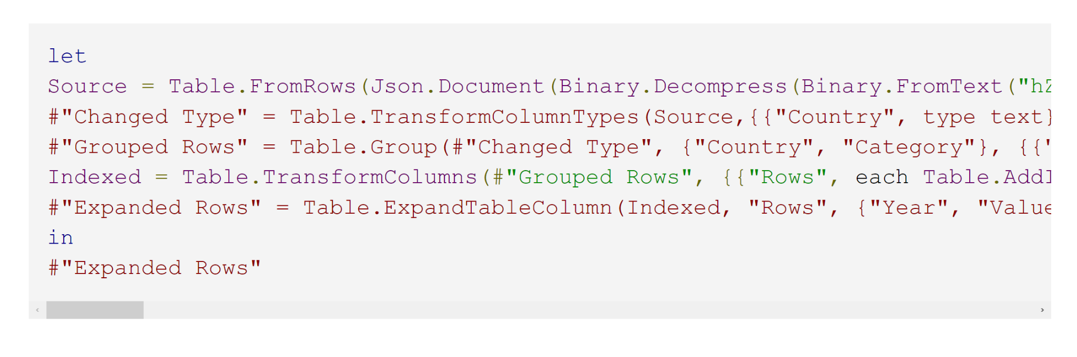
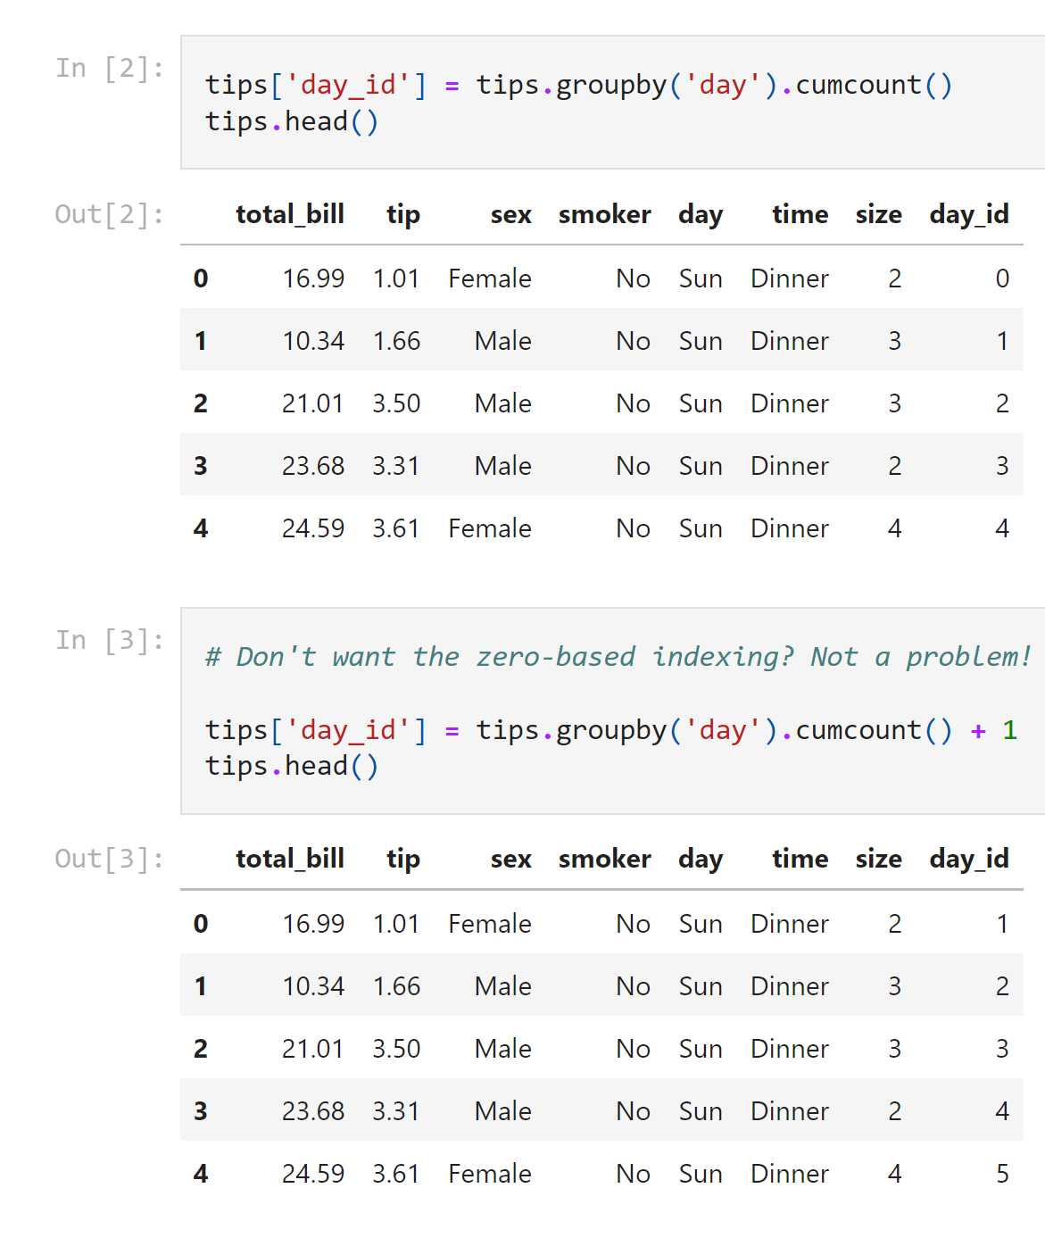
“I want to create an index column by group”
https://datacornering.com/how-to-create-group-index-with-power-query-or-r/
https://gist.github.com/summerofgeorge/59642030a112b90d5b04bebf77f53ddd
Notes:
So this means anyone is free to build on it or redistribute it… and that’s how we’ll get our code

Slide 170
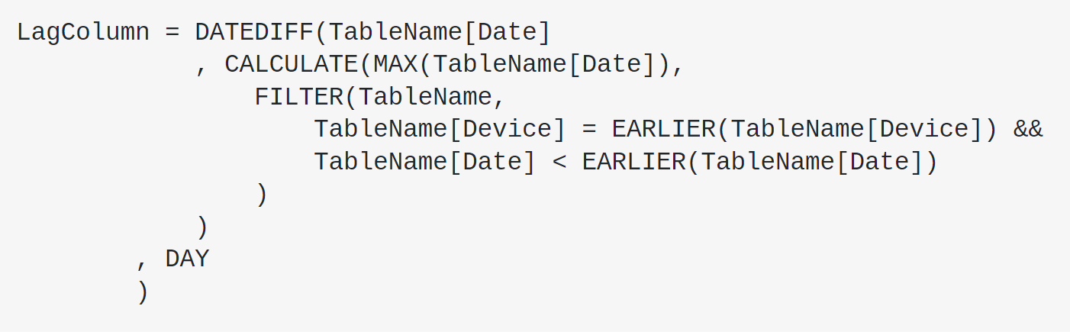
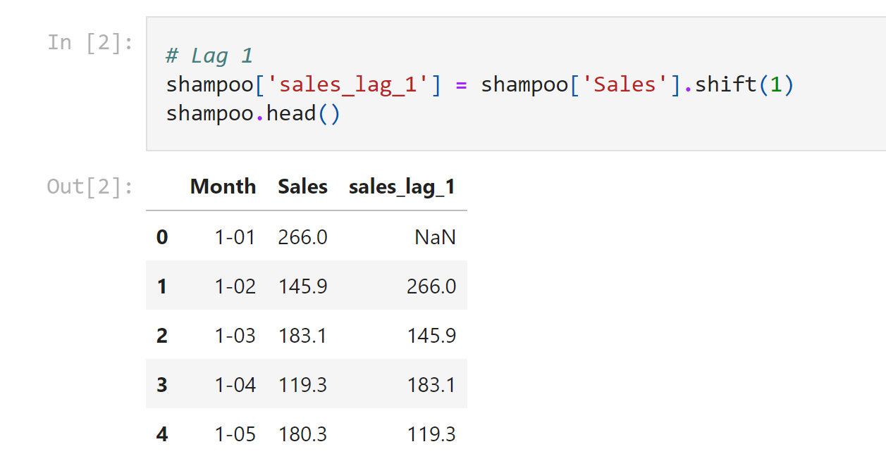
“I want to create a lagged variable”
https://stackoverflow.com/questions/37446950/powerbi-time-lag-calculation-in-dates-using-query-editor
https://gist.github.com/summerofgeorge/a53be111c3d2b4da5ffaf0d732f3bb53
Notes:
So this means anyone is free to build on it or redistribute it… and that’s how we’ll get our code

Slide 171
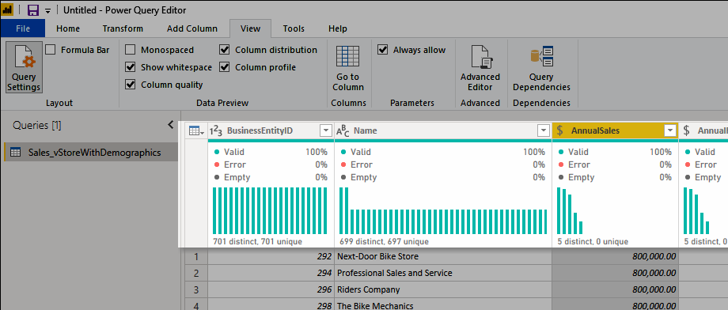
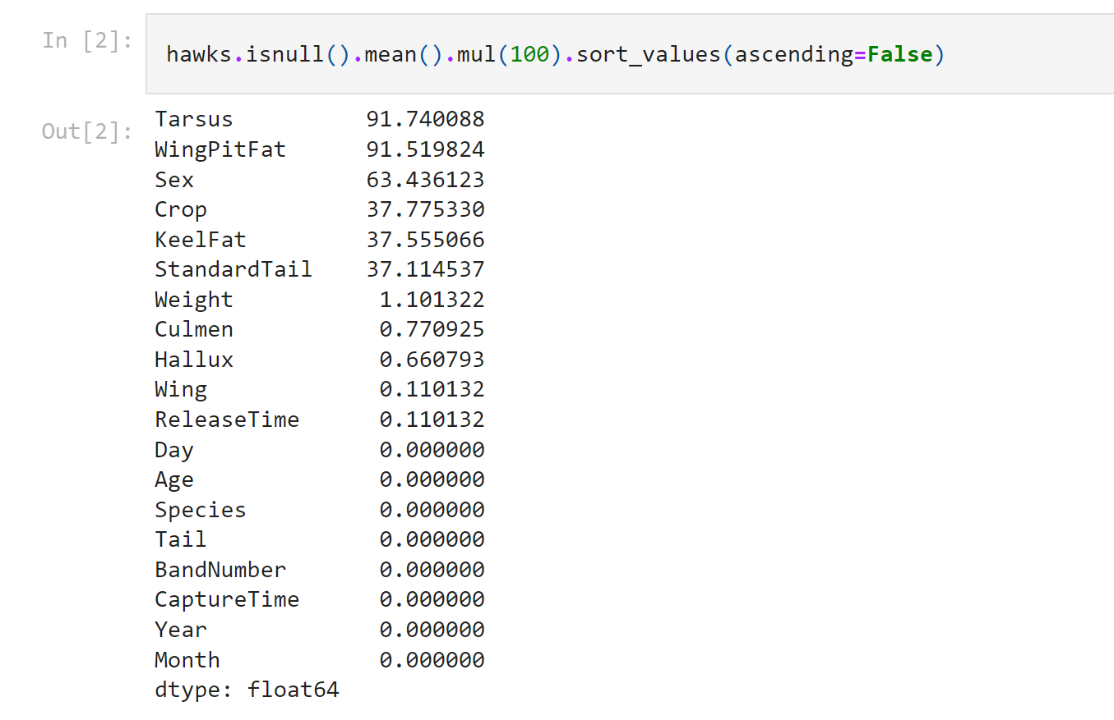
“I want to know what percent of each column are missing values”
https://docs.microsoft.com/en-us/power-query/data-profiling-tools
https://gist.github.com/summerofgeorge/23202b54454af7518dd9fe5c3baec7dc
Notes:
So this means anyone is free to build on it or redistribute it… and that’s how we’ll get our code

Slide 172
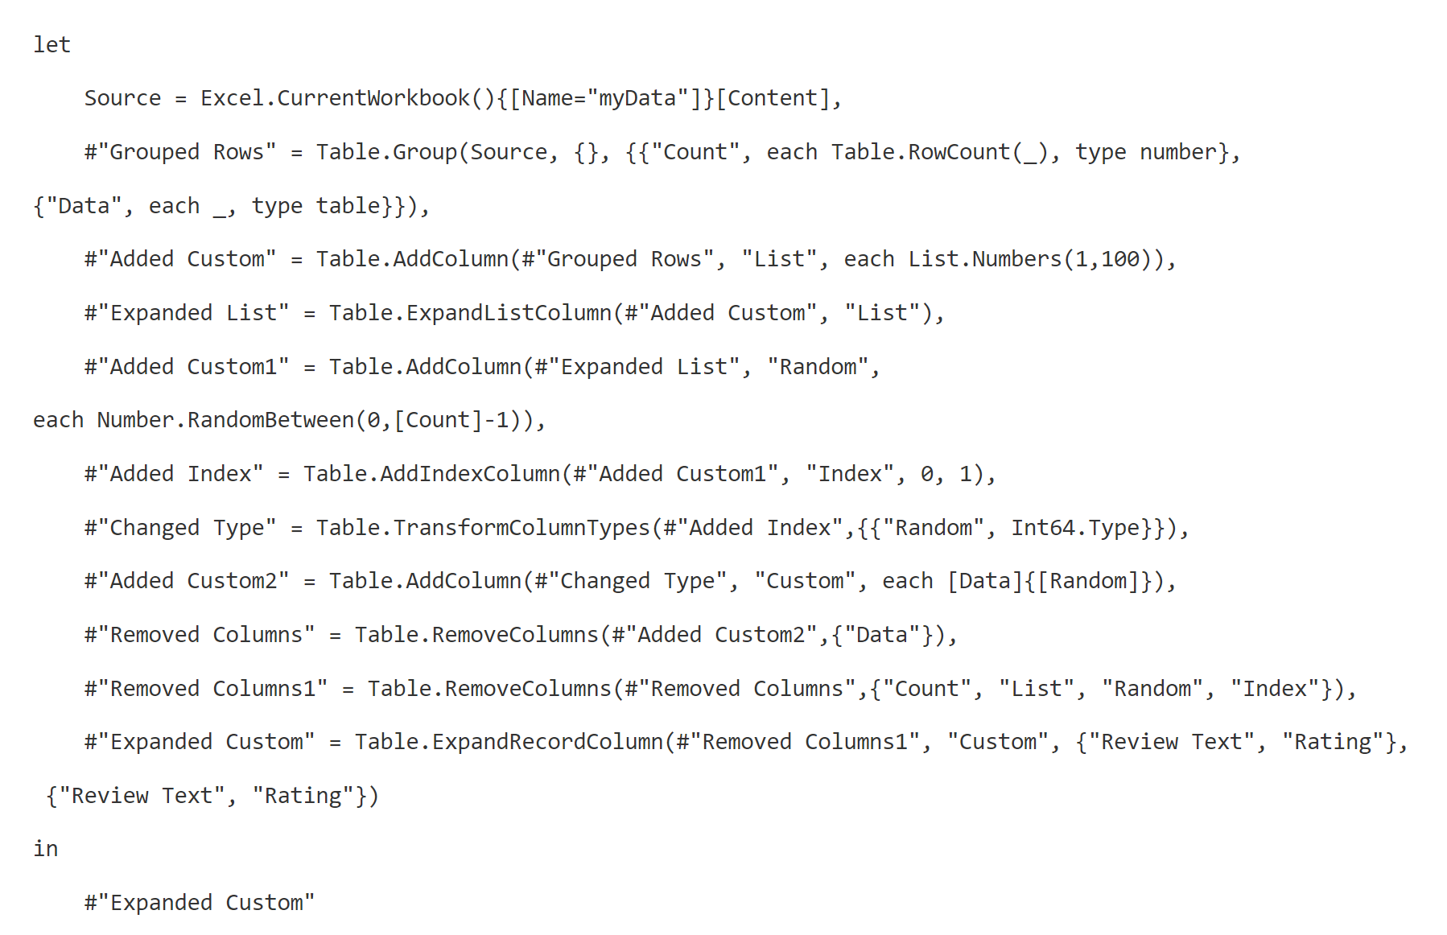
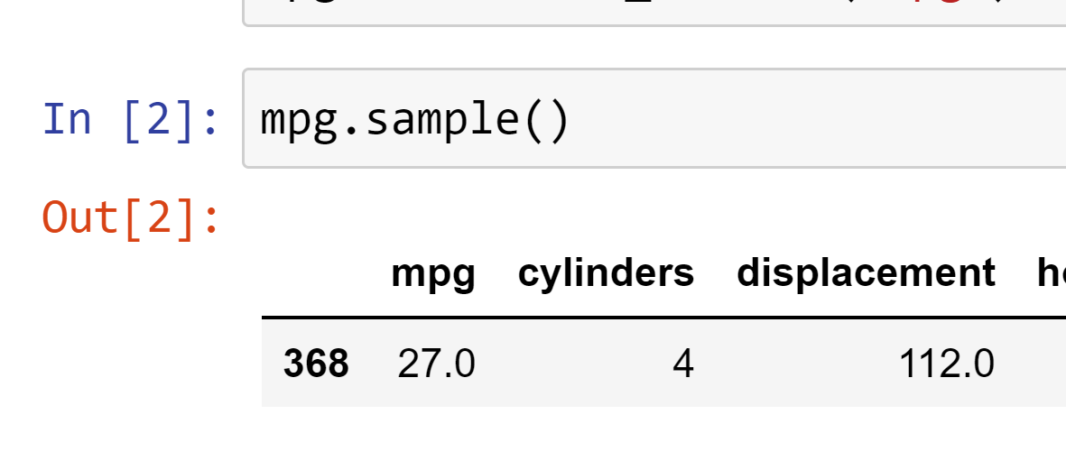
“I want to pick a row at random from my very large dataset”
https://chandoo.org/wp/power-query-random-sample/
https://gist.github.com/summerofgeorge/631ad40ef849886aee6840a497088aa7
Notes:
So this means anyone is free to build on it or redistribute it… and that’s how we’ll get our code

Slide 173
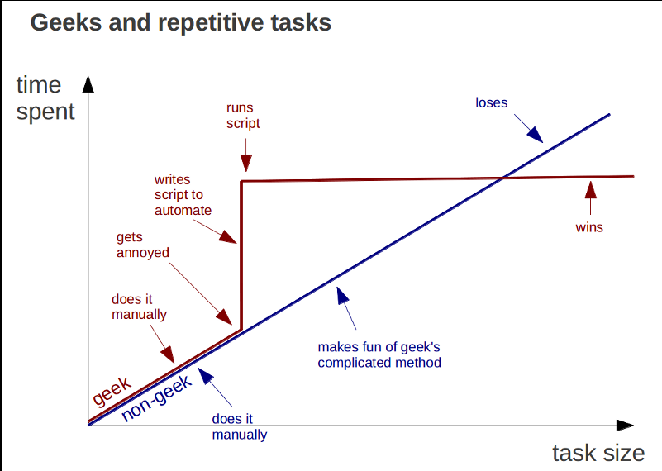
Learning Python is a knowledge investment that pays off
https://marcgg.com/blog/2015/09/30/automate-repetitive-tasks/
Notes:
So this means anyone is free to build on it or redistribute it… and that’s how we’ll get our code

Slide 174
Five things Excel users should know about Python
Notes:
Onto the five things now…

Slide 175
1. Open source means a license to build and distribute
Notes:
Onto the five things now…

Slide 176

What is open source?
“… code that is designed to be publicly accessible—anyone can see, modify, and distribute the code as they see fit.”
- Red Hat, “What is open source?”
https://cloudblogs.microsoft.com/windowsserver/2015/05/06/microsoft-loves-linux/
Notes:
So this means anyone is free to build on it or redistribute it… and that’s how we’ll get our code

Slide 177



Python + Anaconda + Jupyter
The (open) source code
python.org
The “distribution” of code & apps
anaconda.com
The browser-based app
jupyter.org
Notes:
OK now remember that being open source means anyone is free to repackage and redistribute code. In the case of Python the official source code lives with the Python foundation and can be found there. It’s more common however to download from the Anaconda _distribution_ of that code. One of the reasons why is Anaconda comes with some goodies that don’t come with the raw Pyhon installation. One of those is the Jupyter notebook, which is a browser-based app we’ll be using to work with Python.

Slide 178

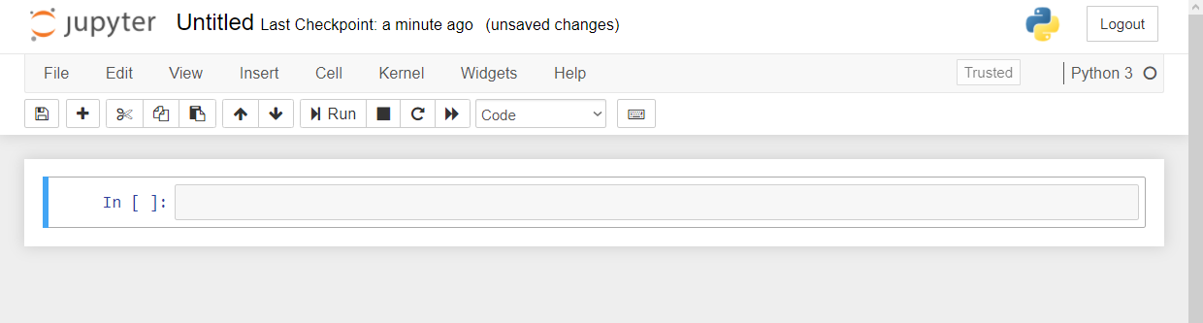

Demo
File: downloading-anaconda.docx
Download Anaconda (or click “launch binder”…)
Start with Jupyter at 1+1…
Menu bar
Toolbar
Code cell
Notes:
OK again, what I want to do here is just show you the basics of working with Jupyter. You will see in the repo there is an option to launch an interactive session, so do that and let’s navigate the four sections of Jupyter and get comfortable working there.
In the demo you’ll get a tour of the notebook and how to work a bit with functions and objects.
Possibly come up with some demo notes for this

Slide 179
2. It’s finnicky… or maybe logical?

Slide 180
Demo
File: thing-2.ipynb
How does Python handle
Case sensitivity?
Indexing?
Whitespace?
Notes:
OK so what we are going to do here is go back to your session or open a new one. Go to the diamonds.r dataset. And let’s actually conduct the analysis that was hinted at earlier.

Slide 181
3. There’s a package for that!

Slide 182

The package two-step…
Install the package if needed
conda install packagename
pip install packagename
Open the package
import packagename
More: https://stringfestanalytics.com/sourcing-python-packages/
Notes:
Now another thing unique to open source programs is this idea of packages. You can kind of think of this as like add-ins for Excel – the analogy I like to use is as apps on a phone.

Slide 183
You won’t get far without these…
Package | Description
numpy | Designed for numerical computing
pandas | Designed to work with panel data and other tabular data structures (think rows and columns. This package leverages code from numpy.
matplotlib | a popular package for data visualization
seaborn | another package for data visualization, built on top of matplotlib and designed to work well with pandas.

Slide 184
Demo
File: thing-3.ipynb
Import from the Standard Library
Confirm packages available to you
Import and alias pandas
Notes:
OK again, what I want to do here is just show you the basics of working with Jupyter. You will see in the repo there is an option to launch an interactive session, so do that and let’s navigate the four sections of Jupyter and get comfortable working there.
Possibly come up with some demo notes for this

Slide 185
Questions?
Notes:
Any questions so far about using R?
Again I just want to show you how easy it is to get up and running there as an Excel user and what to expect when working with open source programs.
Now I guess one of the questions I might have in your shoes is what’s the big deal, we can do the same kind of stuff with Power Query. So I want to acknowledge that.

Slide 186
4. It can augment and automate Excel

Slide 187
So many choices, so many use cases…
Package | Pros | Cons
xlsxwriter | Write almost anything from Excel from Python (data, formats, workbook settings, etc.) | Writes to Excel only/no reading
xlwings | Feature-rich: write data/UDFs, call VBA procedures, robust debugging tools | Local Python/Excel downloads needed
openpyxl | Read and write .xlsx, .xlsm Excel files | Limited ability to edit files
pyxlsb | Read and write .xlsb files | Limited features
xlrd, xlwt, xlutils | Can work with .xls files | Limited features
Notes:
Now another thing unique to open source programs is this idea of packages. You can kind of think of this as like add-ins for Excel – the analogy I like to use is as apps on a phone.

Slide 188
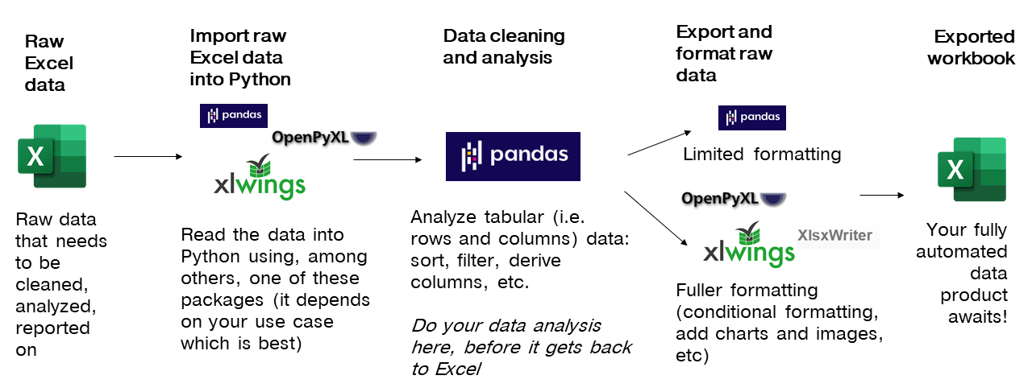
Notes:
Now another thing unique to open source programs is this idea of packages. You can kind of think of this as like add-ins for Excel – the analogy I like to use is as apps on a phone.

Slide 189
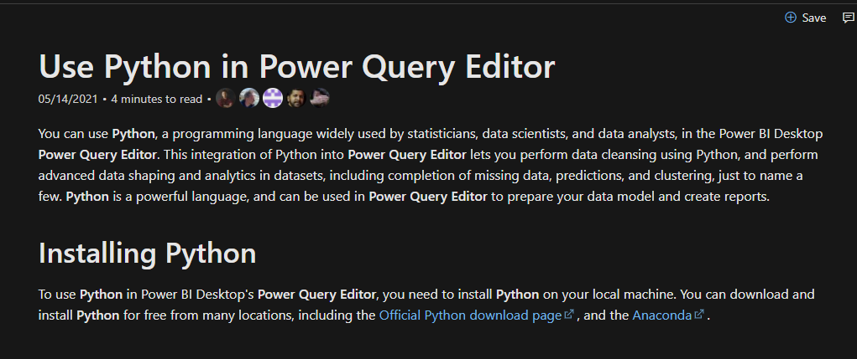

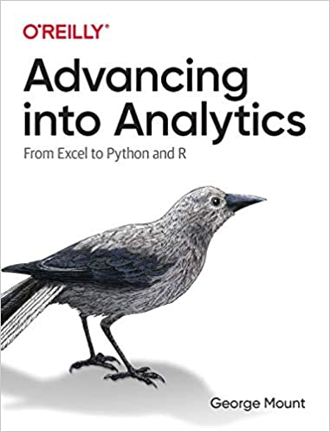
You’re not leaving the stack…
Notes:
One of the things that people get confused about is why learn Python if you’re getting into Power Query… or which to focus on.
You’re not leaving Microsoft’s stack. I have some documentation and a great book here. Now of course these are more about PowerBI but there’s every indication there’s more to come with Excel.

Slide 190
5. It’s not worth panicking over
Notes:
Now this is scary, it’s literally learning another language!

Slide 191
Demo
File: thing-5.ipynb
Some ways to get help from right inside Jupyter…
Notes:
OK again, what I want to do here is just show you the basics of working with Jupyter. You will see in the repo there is an option to launch an interactive session, so do that and let’s navigate the four sections of Jupyter and get comfortable working there.
Possibly come up with some demo notes for this

Slide 192
Finale

Slide 193


Let’s play DataBaseball! data-baseball.ipynb
2. Profile the data
3. Analyze the data
1. Import the data
4. Export results to Excel
Notes:
Start by: 9:35
Link to notebook: https://github.com/summerofgeorge/modal-python-da/blob/main/modal-python-big-picture.ipynb
Read in data from Sean Lahman’s baseball database
Visualize and explore records – what does this data look like? What can it tell us? What do we need to do to get it clean?
Salary analysis: Do higher payrolls attract larger crowds?
Produce presentation-worthy Excel summary workbook from Python

Slide 194
Questions about Python?
Notes:
Any questions so far about using R?
Again I just want to show you how easy it is to get up and running there as an Excel user and what to expect when working with open source programs.
Now I guess one of the questions I might have in your shoes is what’s the big deal, we can do the same kind of stuff with Power Query. So I want to acknowledge that.

Slide 195
Conclusion

Slide 196
Recap
What is sticking with you?
What do you hope to use soon?
What isn’t clear now? (Or, what is clear?)
Notes:
So this means anyone is free to build on it or redistribute it… and that’s how we’ll get our code

Slide 197
Recap
What is sticking with you?
What do you hope to use soon?
What isn’t clear now? (Or, what is clear?)
Notes:
So this means anyone is free to build on it or redistribute it… and that’s how we’ll get our code

Slide 198
Event survey: https://swiy.co/event-survey

Slide 199
THANK YOU
george@stringfestanalytics.com
linkedin.com/in/gjmount
stringfestanalytics.com/contact

Slide 200
BONUS! LINEAR REGRESSION
Notes:
All right! Final chapter. Let’s get into linear regression. You are going to see that while regression has its roots in correlation, the way it works is a little different.
You’ve probably all heard that correlation does not equal causation. Well, what does that mean? Let’s take a look right now.

Slide 201
PEARSON CORRELATION
Notes:
This is correlation, we are going to do the Pearson correlation. As always let’s step through the assumptions and hypotheses.

Slide 202
ASSUMPTIONS
Two variables are normally distributed
Relationship between two variables is linear
No influential cases
Notes:
OK, in this case we still assume normality, nothing new there. A couple new ones though next. First is that we have a linear relationship between our two variables, you will see what that means as we get into the demos.
Another new one is that there should be no influential cases, this is similar to the concept of an outlier that you may be familiar with.
Because in this process we are looking for a pattern to extrapolate. If there are any individual observations that don’t fit that pattern, that will skew off the pattern.

Slide 203
HYPOTHESES
Use this rule of thumb for now:
Correlation coefficient | Interpretation
-1.0 | Perfect negative (linear) relationship
-.7 | Strong negative relationship
-.5 | Moderate negative relationship
-.3 | Weak negative relationship
0 | No (linear) relationship
+.3 | Weak positive relationship
.5 | Moderate positive relationship
.7 | Strong positive relationship
+1.0 | Perfect positive (linear) relationship
Notes:
Now, there is a way to write a formal hypothesis and test for the statistical significance of correlations, but for now let’s just focus on interpreting the raw “correlation coefficient” that is returned when you correlate two variables. This figure will go from -1 to 1 and it indicates the strength of the linear relationship between two variables.

Slide 204
Correlations
Demo: iris-corr.xlsx
Printing a correlation matrix
Visualizing a bivariate relationship: scatter plots
X-axis: independent variable
Y-axis: dependent variable
Notes:
OK, let’s take an example using the iris dataset. As with most statistical analyses, we will want to both crunch the numbers and draw a picture. These will both give us important context.
Now when we plot our variables, we are going to always plot the independent variable on the left and the dependent on the right. Are you familiar with this concept? Let’s do the plotting and then come back to the importance here.

Slide 205


WHICH CAME FIRST: THE INDEPENDENT OR DEPENDENT VARIABLE?
Independent variable:
Controlled as part of experiment
Dependent variable:
Affected by change in independent variable
Notes:
Now a classic example of independent versus dependent variables is watering and plant growth. Our independent variable comes first, this is the thing controlled by the researcher, and does not affect the phenomenon of interest. So watering is our independent variable, it’s what we do to observe the results on plant growth.
Our hypothesis then would be that there is no effect of watering on plant growth – that’s our null. So that means our dependent variable is affected by the independent variable. That is how these work. This is going to become very important here in a bit when we get into regression.

Slide 206
Every picture tells a story
Be careful about linearity!
Demo: anscombe.xlsx
Notes:
Now let’s take a moment to walk through an example of why it’s so important to draw a picture of your variables’ relationships. Let’s walk through the Anscombe dataset.

Slide 207
DRILL
mpg.xlsx
Produce a correlation matrix
What is the strength of the relationship between weight and acceleration?
Plot the relationship.
Notes:
OK, now that you see the importance of the matrix and the charts, go ahead and do a correlation matrix, and focus your attention on examining the relationship between weight and horsepower.

Slide 208


Correlation | Regression
Indicates the extent to which two variables move together linearly | Indicates the estimated impact of a unit change of the independent variable X on the dependent variable Y.
Notes:
OK. We now know that correlation measures the extent to which two variables move together linearly. And we drew that relationship with a scatter plot.
Now let’s do something a little different, we are doing to fit a line through that scatterplot. And this line will indicate how much we estimate a change in X will affect Y.
It’s a subtle difference, but they are different. So maybe take some time later today, just print out this slide, keep looking at it and it will click I think.

Slide 209
ASSUMPTIONS
Linear relationship between independent and dependent variable
No influential cases
Values of residuals are independent
Variance of residuals is constant
Values of residuals are normally distributed
Notes:
Ok, off to the assumptions like the other tests we’ve done. One is that there is a linear relationship between the variables, we had the same for correlation. Also, no influential cases. The other ones we won’t get into so much. They have to do with the residuals, which you will learn about in a bit.

Slide 210
EXPLICIT WARNING:
MATH AHEAD
Notes:
Brace yourselves! I want to show you the formula for the line that we are going to fit into our scatter plot.

Slide 211
LINEAR REGRESSION EQUATION
Independent / response variable
Slope coefficient
Error term
Dependent / predictor variable
Y intercept
$$Y_{i}=β_{0}+β_{1}{∗X}_{i}+ε_{i}$$
Notes:
Again, we are predicting Y with a straight line. This line will have three components – first is going to be the y intercept. Then we will find a coefficient of the slope multiplied by our independent variable.
Then there will be some random error. This is the variation in the dependent variable that our independent variable doesn’t explain.

Slide 212


HYPOTHESES
Ho: No relationship between X and Y. The slope equals zero.
Ha: A relationship between X and Y. The slope does not equal zero.
Notes:
Now, the hypotheses. Again, it’s all about this fitted line. If the slope of the line is equal to zero, we really can’t say how 1 unit of X influences Y.
Now, there is a series of steps, or an algorithm to use the fancy word, used to actually fit that line, but we will let Excel do it for us. And we will get something like the next slide.

Slide 213



$$Residual=Y−\hat{Y}$$
Observed value
Estimated value
Notes:
Now, here is a pretty small scatter plot where we have fitted a line between these points. We have our actual points from the scatter plots, and the estimates based on where those X values fit on the line. This is the difference between the actual, and the estimated, and this is the residual. You can think of it as the leftover between the scatterplot and the line.

Slide 214
DEMO
mpg-regression.xlsx
Is there a significant relationship between weight (X) and acceleration (Y)?
Notes:
OK, that was a ton of information! Let’s walk through and do this in Excel.

Slide 215
DRILL
mpg-regression-drill.xlsx
Is there a significant linear trend between weight (X) and displacement (Y)?
Notes:
OK now it’s your term to do the same on another dataset that you should be pretty familiar with.

Slide 216
DRILL
Researchers have found that the results of a linear regression of shark attacks (Y) on ice cream consumption (X) returns significant results.
Do ice cream cones influence shark attacks?
Notes:
There is no dataset for this one, just think it through.

Slide 217



THE DEPENDENT, THE INDEPENDENT, AND THE CONFOUNDING
Notes:
OK it’s important not to misattribute causality. Remember that our independent variable is unaffected by the experiment and our dependent variable is affected by our independent variable. It sounds like ice cream and shark attacks fit that pattern. Ice cream consumption up, shark attacks up. But does increased ice cream really lead to increase shark attacks, or are both influenced by rising temps? This is called a confounding relationship, where it turns out each are dependent variables of the same IV, but we think it’s an IV/DV relationship.

Slide 218
MODEL DIAGNOSTICS: R-SQUARE
Regression model
What % is explained here? This is r-square
Variability of Y
Error
This remains unexplained
Notes:
Great, now that you have used Excel to fit that line between X and Y, let’s take a couple of extra steps to interpret our model. We already saw from the p-value that the slope of our line is significantly different from zero. But this doesn’t tell us how much of Y is explained by X – for this, we will use r-square.
This goes back to the error term. Everything we can’t explain in y’s variability is error. The part we can explain is the R-square. R-square is based in a percentage amount. It’s there in our Excel output, so we’ll go back and interpret it.

Slide 219
INTERPRETING R-SQUARE
R-square value | Interpretation
.05
.66
.92
Notes:
Take a moment to practice interpreting R-square.

Slide 220
INTERPRETING R-SQUARE
R-square value | Interpretation
.05 | 5% of the variability in Y is explained by X
.66 | 66% of the variability in Y is explained by X
.92 | 92% of the variability in Y is explained by X
Notes:
Again, r-square tells us what % of the variability in Y is explained by X.

Slide 221

MAKING POINT PREDICTIONS
$$\hat{Y}=β_{0}+β_{1}{∗X}_{i}$$
$$\hat{Y}=10+.5∗4$$
$$12=10+2$$
Notes:
Another thing we can do is use our fitted line to predict values of Y given an X value. This predicted value is indicated as y-hat. So, here’s the equation of our fitted line. Let’s say our Y-intercept was fit to 10 and the slope is .5.
If our estimated value of X is 4, then our predicted value of Y is 12.

Slide 222
DEMO
mpg-regression-diagnostics.xlsx
Locate and evaluate r-square
What is the predicted mpg for a car weighing 3,000 pounds?
Notes:
OK, let’s take our mpg regression model to the next level.

Slide 223
DRILL
housing-regression-diagnostics-drill.xlsx
Locate and evaluate r-square
What is the predicted displacement of a car weighing 3,000 pounds?
Notes:
Now it’s your turn.

Slide 224
QUESTIONS?
Notes:
We really just scratched the surface here with linear regression! But hopefully it gives you a sense of how it works. And really it’s so foundational to data analysis. It really bridges the gap between stats and data science.

